Slide 1


Decentralized AI: Economics of Trust
Zishuo Zhao PhD Candidate (ABD), University of Illinois Urbana-Champaign
MIT DSL Seminar
October 17, 2025
Notes:
A

Slide 2
Self Introduction
5th year PhD Candidate (ABD), UIUC ISE
Advisor: Yuan Zhou (@Tsinghua now)
Research Interest: Game Theory, Blockchain, Trustworthy AI
Visited MIT DSL Lab from 2023.9 to 2024.8
But my story with Boston actually begins earlier.
Notes:
, back in the spring of 2022.

Slide 3
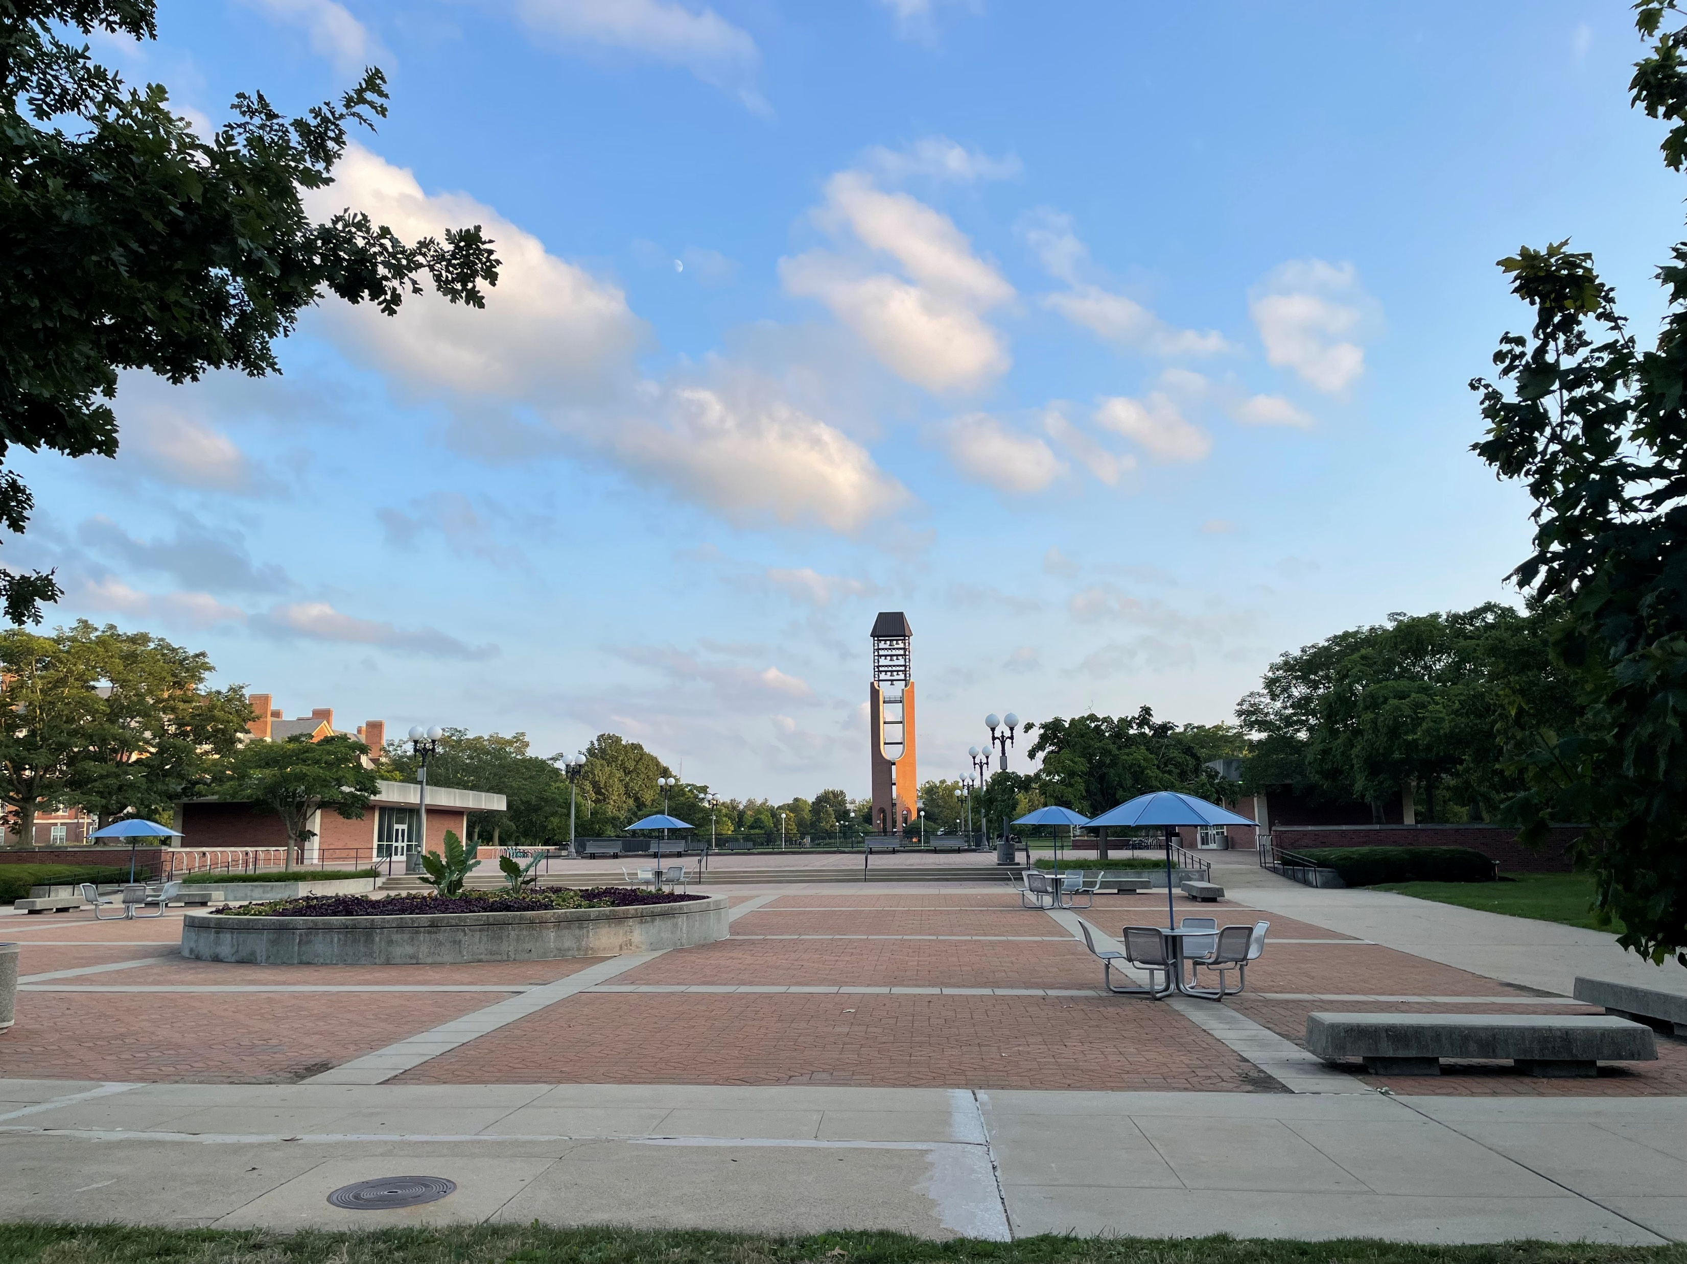
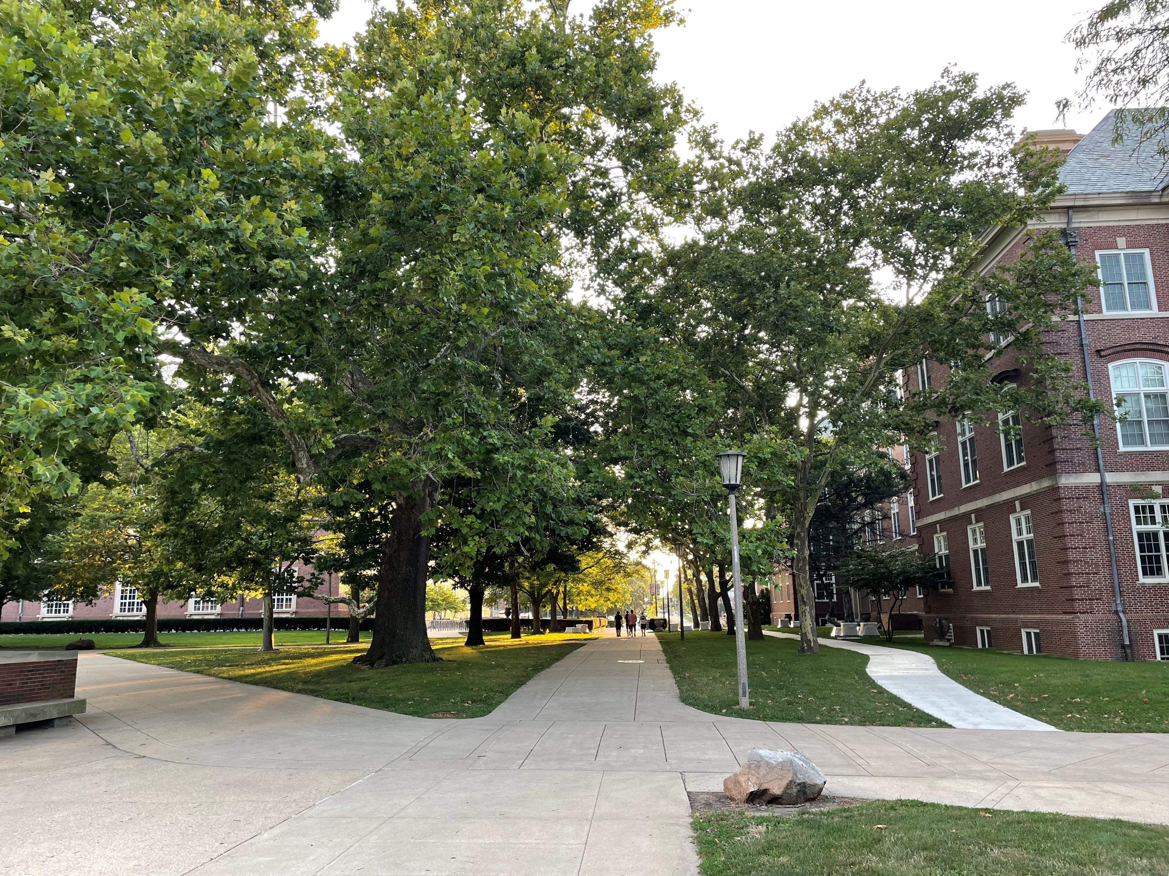
Life before ChatGPT: First Impression @ UIUC
Admitted to UIUC in Spring 2021. (Due to Covid)
Physically arrived at UIUC: Aug 16, 2021
A quiet & beautiful campus!

Slide 4
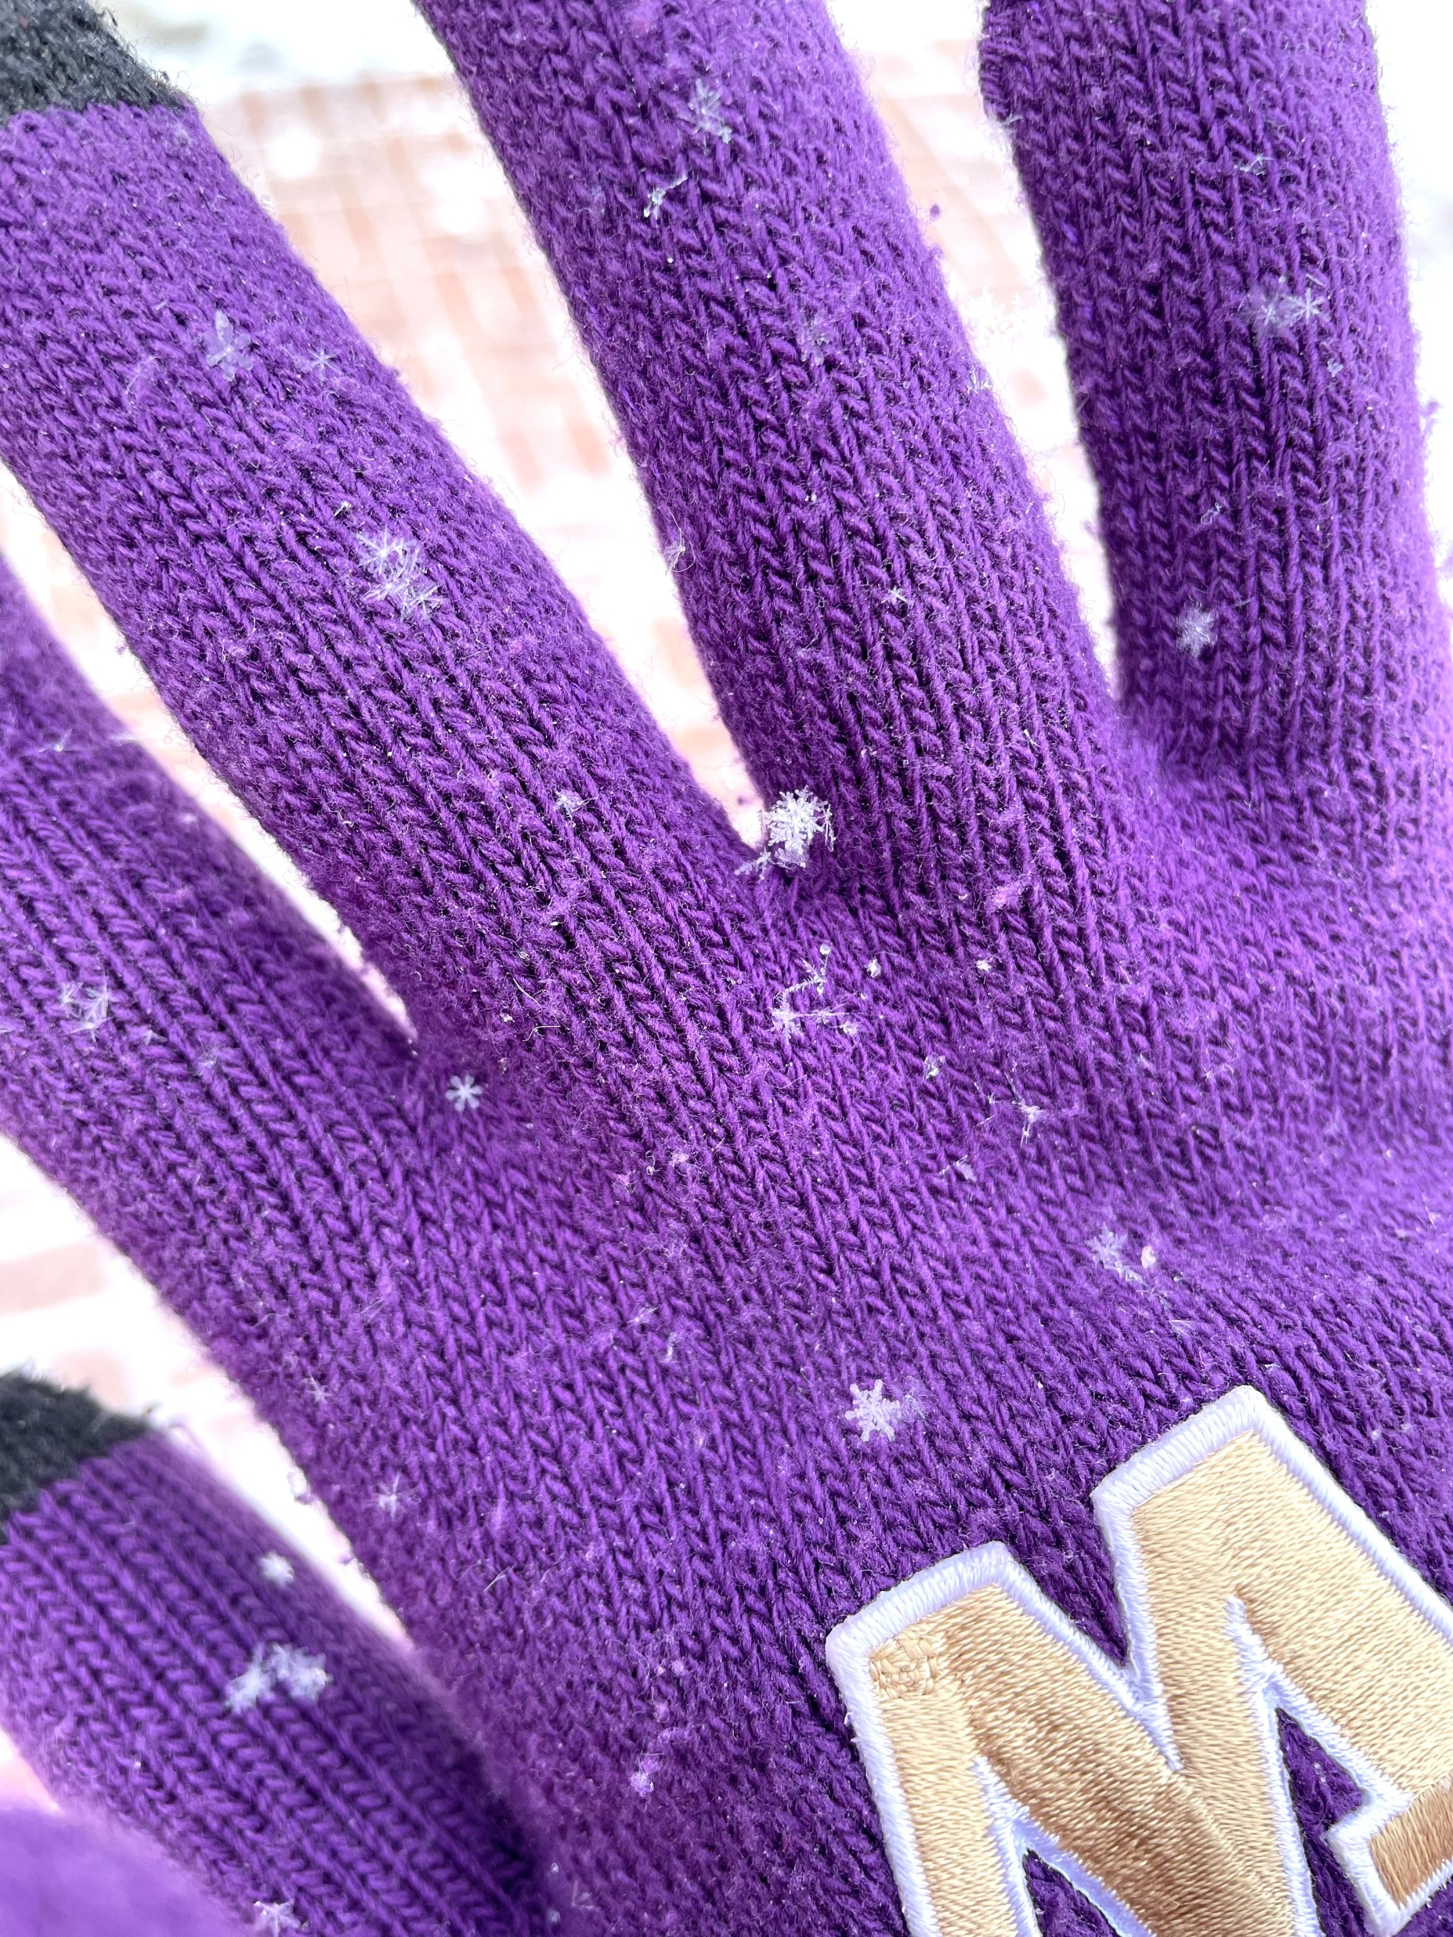

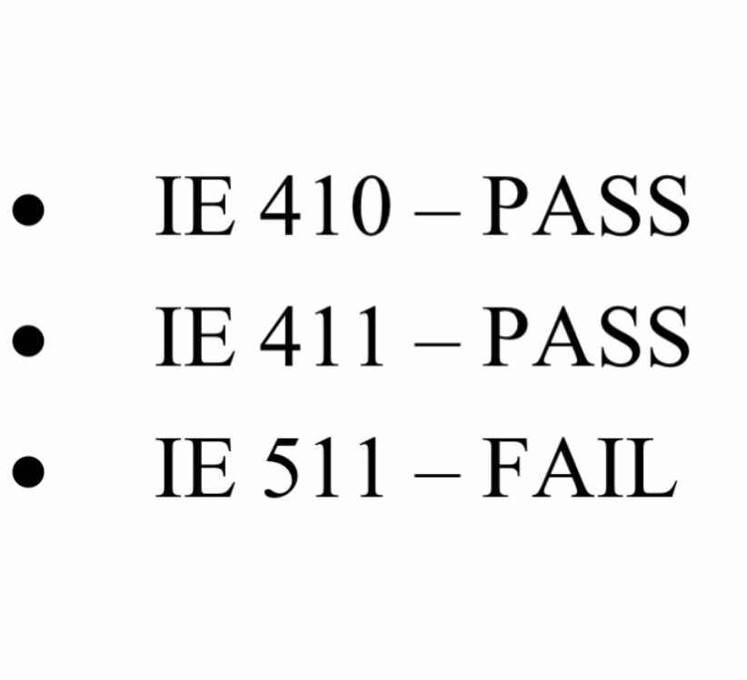
Life before ChatGPT: Before Spring Comes
The winter of Champaign is so cold… (maybe as cold as Boston!)
The qualification exam was not that easy! (Feb 2021)

Slide 5
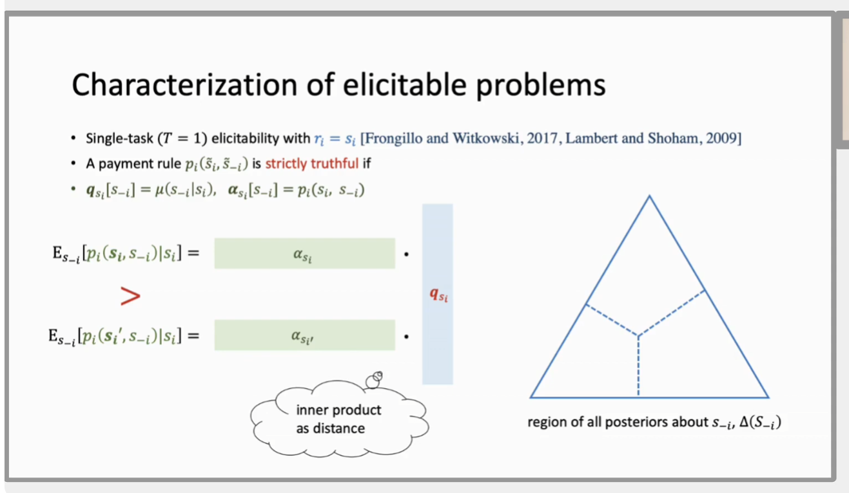
Life before ChatGPT: A Glimpse in April
“How could I love the world,
while I can't see it clearly?”
Peer Prediction: Incentivizing truthful reports without access to ground truth.
I came across an online talk… (Apr 3, 2022)

Slide 6

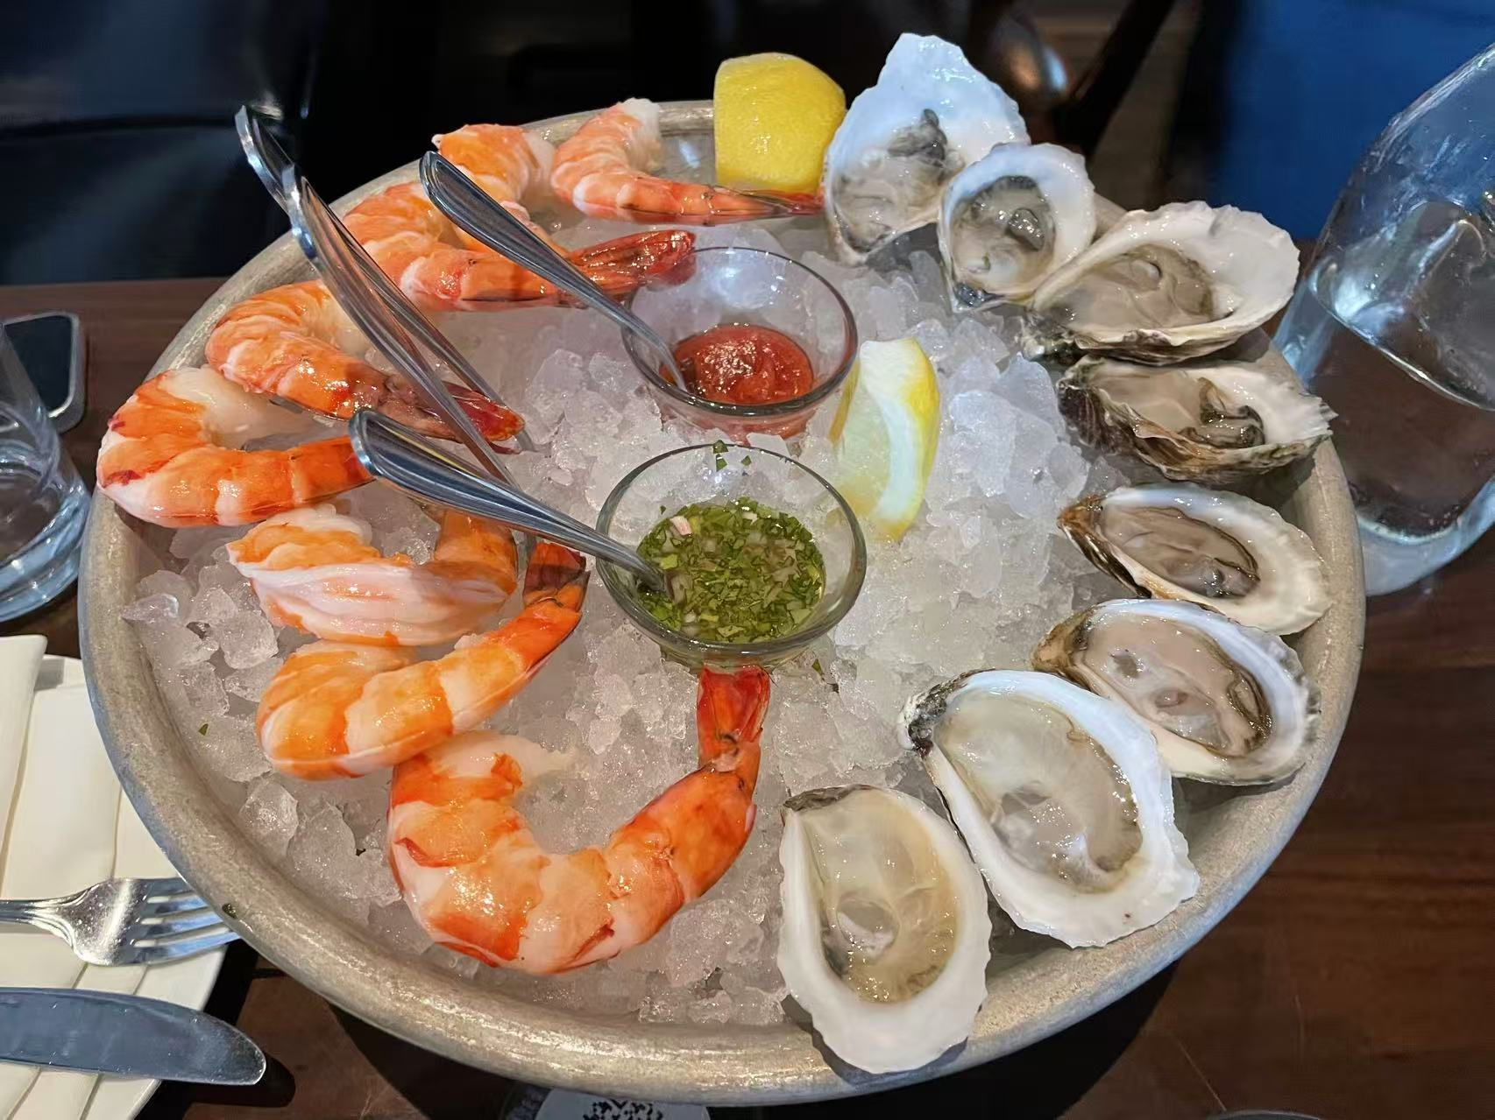
Life before ChatGPT: Coup de Coeur
Life may be difficult,
but EconCS is amazing!
“I should come to Boston
to see my senior friend in person.”
@May 20, 2022

Slide 7
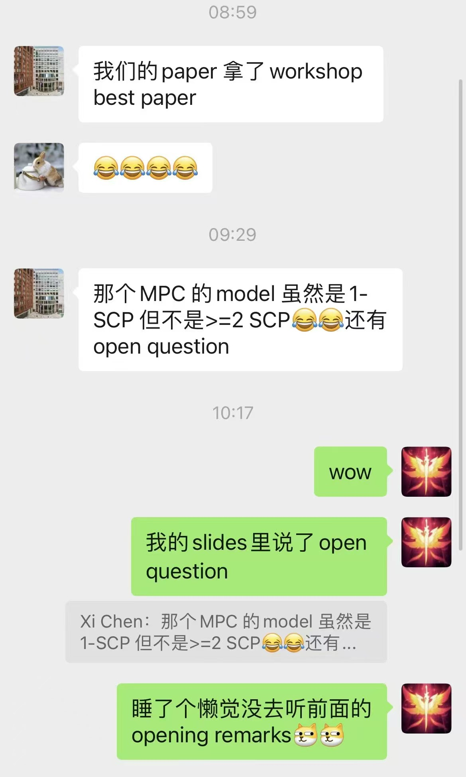
Life before ChatGPT: The Starry Twilight
I want to work on… mechanism design!
Oops! How did I get the best paper award with my first blockchain mechanism paper?
Let’s visit MIT and make Web3 great again!
@Dec 3, 2022

Slide 8

Life before ChatGPT: Arrival
At the end of 2022.
I: Why the * should I follow the hype?
But… The LLM era did come.
“ChatGPT is the future!”
“Let’s all in LLM!”

Slide 9
Artificial Intelligence: The New Moore’s Law
Deep Blue (1997): AI for chess
AlphaGo (2017): AI for Go
ChatGPT (2022): AI for chatting…
Or everything?
Scaling Law: the capability of AI will improve consistently with the development of data, computing power and models.
“The Bitter Lesson” (Richard Sutton, 2019) Given enough resource, brute-force computation will eventually outperform human wisdom.

Slide 10
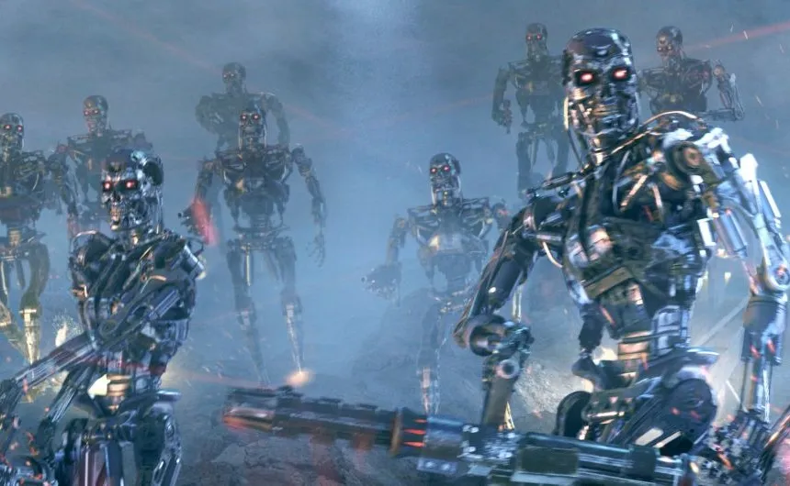
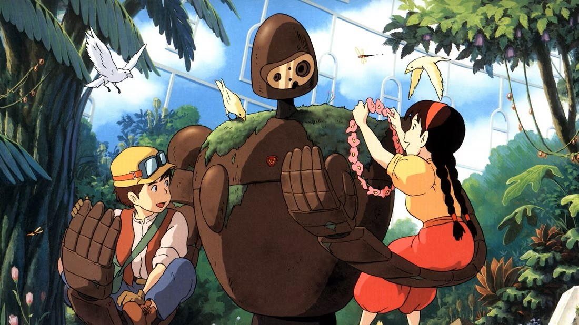
AI Safety: A Critical Concern in AGI Age
ChatGPT: herald of AGI age.
AI safety: the stronger AI becomes, the higher risk it might do evil.
AI alignment: make sure that AI’s behavior aligns with human interest.
Terminator (1984)
But… How to ensure the AI model is really aligned as claimed?
Laputa: Castle in the Sky (1986)

Slide 11
AI Safety: Threat of Untrusted Training
Malicious attacks: Bytedance (TikTok) LLM training was attacked by a malicious intern in 2024 (who got a Best Paper Award!)
Conflict of interest: If the AI is owned by a centralized party, the party may manipulate the alignment target for their interest.
Blockchain: a decentralized platform aimed for trustworthiness.

Slide 12
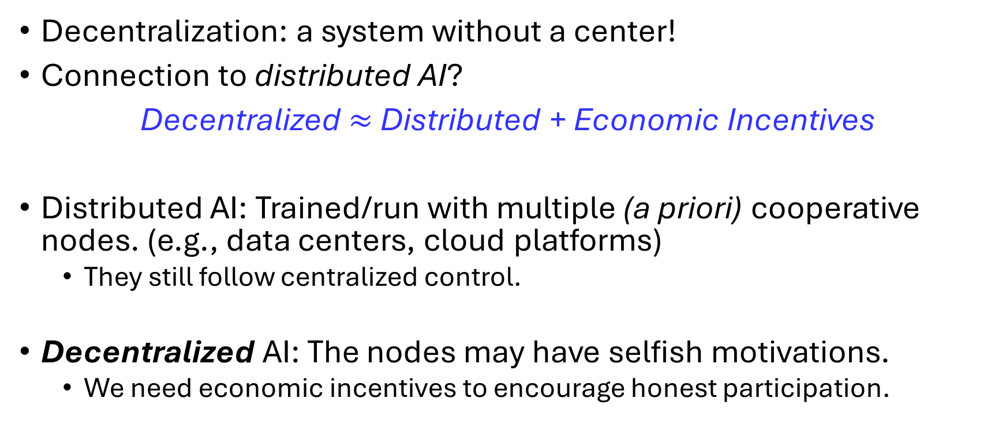
What is Decentralized AI?
Decentralization: a system without a center!
Connection to distributed AI?
Decentralized $≈$ Distributed + Economic Incentives
Distributed AI: Trained/run with multiple (a priori) cooperative nodes. (e.g., data centers, cloud platforms)
They still follow centralized control.
Decentralized AI: The nodes may have selfish motivations.
We need economic incentives to encourage honest participation.

Slide 13
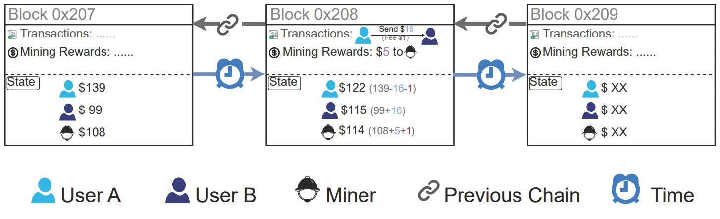
What is the Blockchain?
A growing linked-list stored in a decentralized way.
Each block: (Data, Prev_Hash (pointer), Certificate (PoW, PoS, …) )
The certificate works as an access control for the block; an added block is valid only when the certificate passes verification.

Slide 14
Blockchain Security: Decentralized Consensus
What guarantees the security in a decentralized system?
On centralized systems: assuming the center is honest.
Basic assumption of blockchain: the majority is honest. (i.e. no 51% attack)
Why would the majority choose be honest?
Are humans created good, or evil?
Economic assumption: humans are created rational (selfish)!
Mechanism design:
Develop incentive mechanisms that incentivize honest behavior!

Slide 15
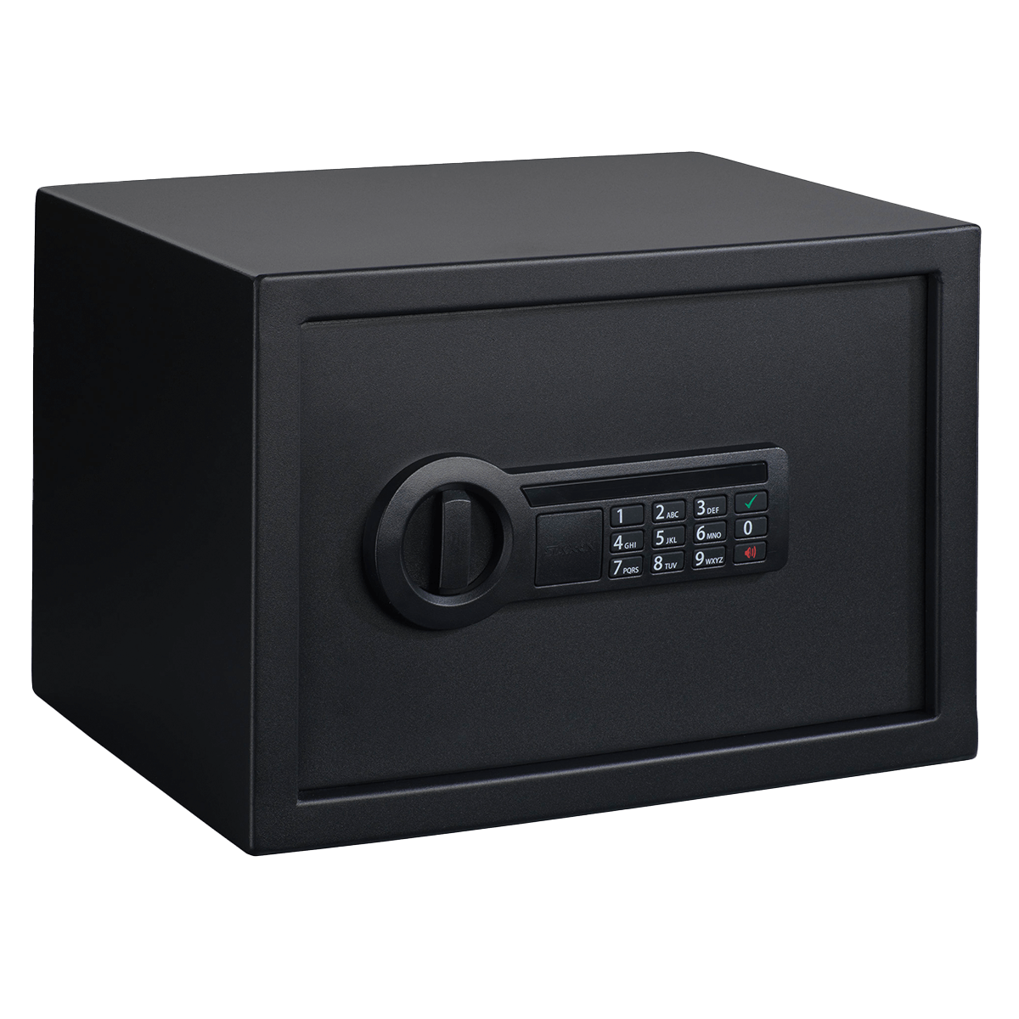
Mechanism Design in Bitcoin: Hash Puzzle
Bitcoin PoW: hard to compute, easy to verify.
“To access the block, find Nonce s.t. Hash(Data, Prev_Hash, Nonce) < Thres before other players!”
BITCOINS INSIDE
Whoever finds a correct password (nonce) gets the bitcoins!

Slide 16
Mechanism Design in Bitcoin: Hash Puzzle
Verification: Hash(Data, Prev_Hash, Nonce) < Thres?
Hard to “guess” a valid Nonce when Thres is small.
Easy to verify whether Hash < Thres…
Guarantees security against sybil attacks, but computation is wasteful!
Wasting a great amount of energy ∼ 120 TWh/year, comparable to a medium-sized country.
“So many labor expended on trying passwords… is wasteful!”

Slide 17
Proof-of-Useful-Work (PoUW)
We don’t hate computation. We hate meaningless computation.
Could we use the PoW to solve useful & computationally intensive problems, e.g.
Training AI models?
Proof-of-Learning (PoL): ML computation as PoUW

Slide 18
Towards the Dream: Proof-of-Learning
Why would Nakamoto (2008) use hash puzzles?
Hard to solve.
Easy to verify.
Controllable difficulty.
Would ML training task satisfy the properties above?

Slide 19
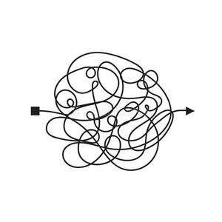
Existing Work: ZKML (zero-knowledge ML)
Prover encode the ML task into cryptographic zero-knowledge proofs.
e.g. zkCNN (Liu et al., 2021), zkGPT (Qu et al., 2025)
Verification process is straightforward.
But zero-knowledge proofs have high (>1000x) overheads!
Even worse with computationally intensive ML tasks.

Slide 20


Existing Work: OPML (“optimistic” ML)
Prover just runs the task.
Verifier re-runs the same task to verify.
Committee voting when disagreement occurs.
>1x overhead (not so easy to verify!).
Subject to Verifier’s Dilemma
Prover
Verifier

Slide 21
Comparison: ZK vs. OP Consensus
ZK Consensus: Provers prove it valid.
“Anything is presumed wrong until proven right”
Conservative: good security but (extremely) low efficiency.
OP Consensus: Verifiers prove it invalid.
“Anything is presumed right until proven wrong”
“Optimistic”: better efficiency but less security (if not well designed).
More responsibility for verifiers!

Slide 22
Comparison: ZK vs. OP Consensus
 | Zero-Knowledge | Optimistic
Prover’s Overhead | >1000x | ~0
Verifier’s Overhead | ~0 | ~1x
Total Overhead | >1000x | ~1x
Core Technique | Cryptography | Game Theory
Main Challenge | ZKP Efficiency | Verifier’s Incentive

Slide 23
How to Build Ideal DeAI
We want to:
Either improve the efficiency of Zero-Knowledge Proofs
Challenge for cryptographers!
Or improve the incentive guarantee of Optimistic protocols
Challenge for mechanism designers (me)!
Or…both?
Challenge for the starry-eyed (^_^)

Slide 24
Challenges of (OP-like) Proof-of-Learning
Is ML training
Hard to solve? Yes!
Easy to verify? It depends on what to verify…
To verify the required amount of computation is correctly done?
We have to train it again for perfect security. (Fang et al., 2023) i.e., at least 1x overhead.
To verify the performance in the inference?
It is hard to evaluate the actual difficulty (even possibility) to achieve given accuracy. (Hoffman, 2022)

Slide 25
Trilemma of Proof-of-Learning (PoL)
Until substantial progress in hard problems in DL theory,
It is difficult to design a PoL that simultaneously satisfies Byzantine security, computational efficiency and controllable difficulty.
Byzantine Security
Why do we want?
Computational Efficiency
Controllable Difficulty

Slide 26
Why Controllable Difficulty?
AI perspective:
Quantify workloads for different tasks.
Price of computation varies with time.
Blockchain perspective:
Need predictable block rates.
More transparent & flexible markets.

Slide 27
Incentive Security: Modeling
Question: Do cheaters really want to cheat (at all costs)?
Byzantine cheaters: players who would attempt to cheat whenever they can.
Rational cheaters: players who would only attempt to cheat if it can increase their (expected) utilities.
In blockchain economy, most miners mine in order to make money.
Most dishonest miners cheat in order to make more money (e.g. selfish mining).

Slide 28
Incentive Security: Modeling
Incentive Security: A system is incentive-secure iff it is secure against rational cheaters.
i.e. parties cannot increase their expected utility via cheating.
Difference from Incentive Compatibility?
Incentive Compatibility: Incentivize rational players to report their true types.
Incentive Security: Players’ action spaces involve computation tasks.
Intuition of relaxation: “milder” cheats are harder to detect, but can be tolerated to some extent.

Slide 29
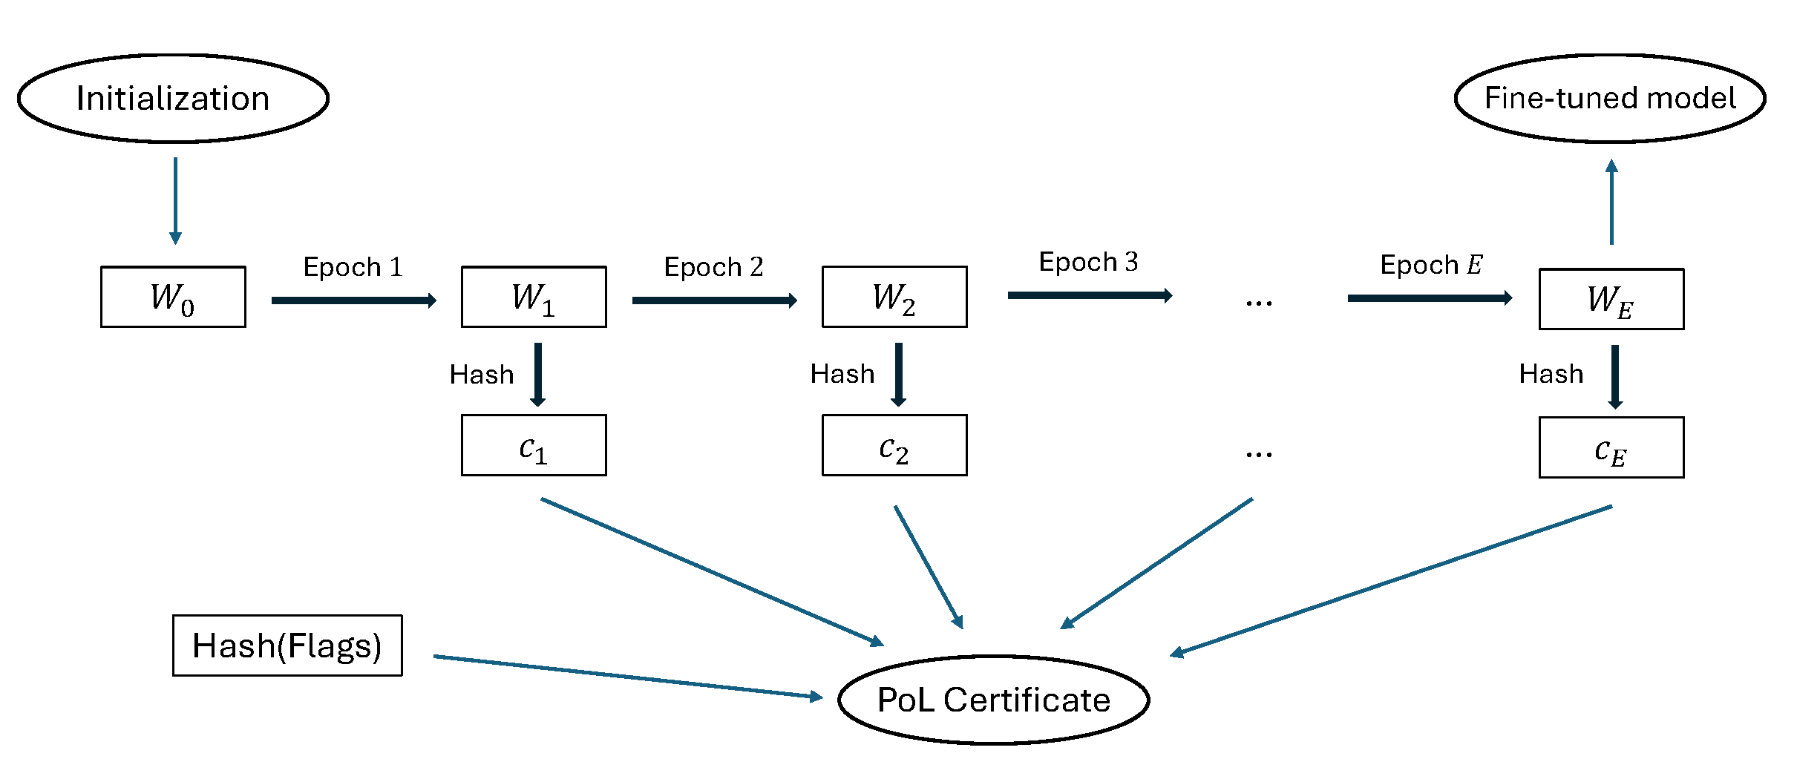
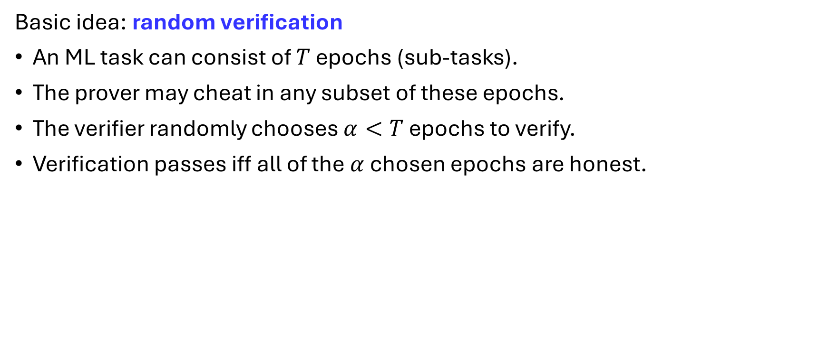
Incentive-Secure PoL Design
Basic idea: random verification
An ML task can consist of $T$ epochs (sub-tasks).
The prover may cheat in any subset of these epochs.
The verifier randomly chooses $α<T$ epochs to verify.
Verification passes iff all of the $α$chosen epochs are honest.

Slide 30
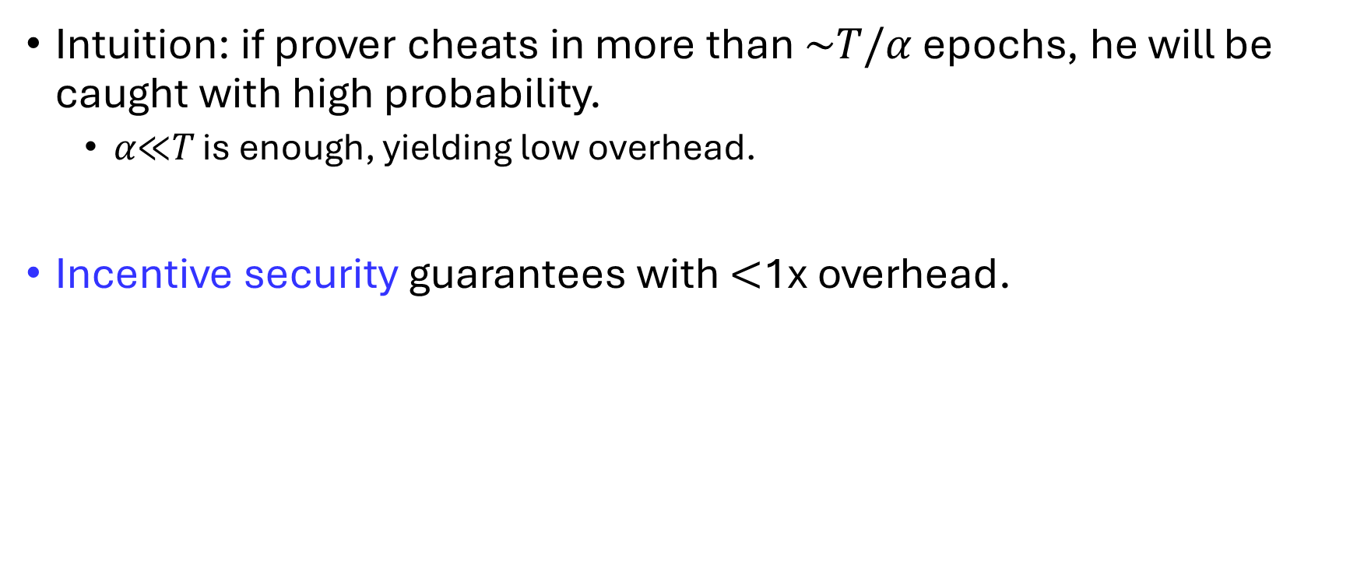
Incentive-Secure PoL Design
Intuition: if prover cheats in more than ~𝑇/𝛼 epochs, he will be caught with high probability.
𝛼≪𝑇 is enough, yielding low overhead.
Incentive security guarantees with $<$1x overhead.

Slide 31
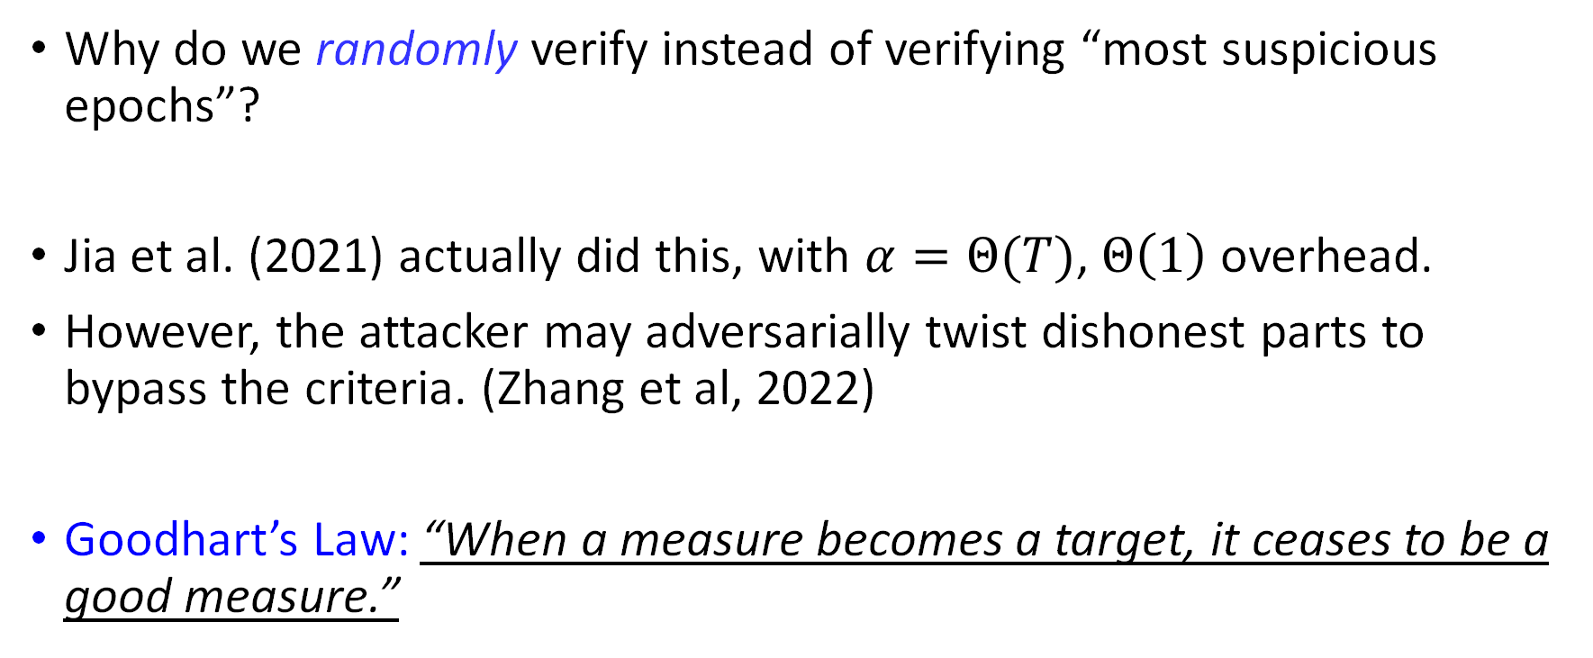
Incentive-Secure PoL: Randomness
Why do we randomly verify instead of verifying “most suspicious epochs”?
Jia et al. (2021) actually did this, with $α=Θ(T)$, $Θ\left(1\right)$ overhead.
However, the attacker may adversarially twist dishonest parts to bypass the criteria. (Zhang et al, 2022)
Goodhart’s Law: “When a measure becomes a target, it ceases to be a good measure.”

Slide 32
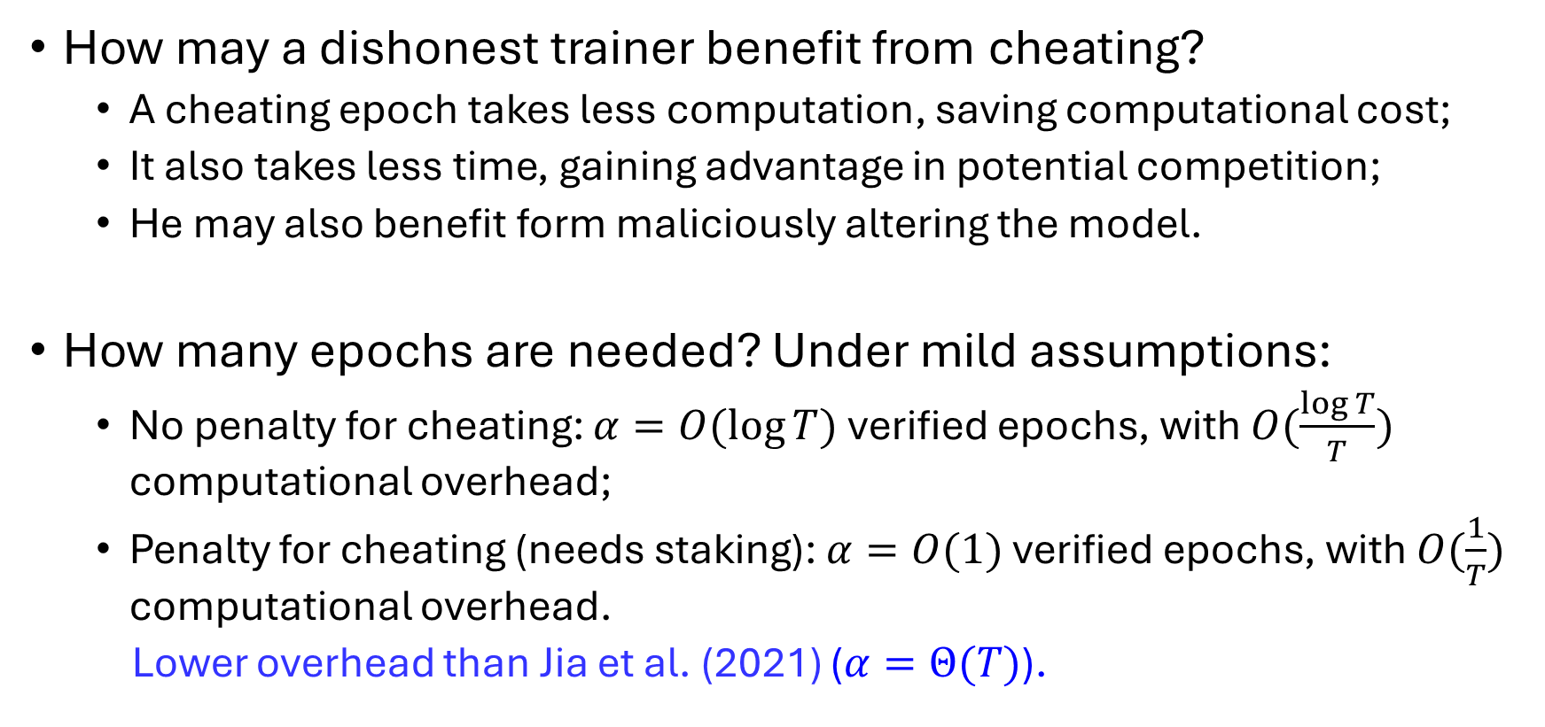
Incentive-Secure PoL: Theoretical Results
How may a dishonest trainer benefit from cheating?
A cheating epoch takes less computation, saving computational cost;
It also takes less time, gaining advantage in potential competition;
He may also benefit form maliciously altering the model.
How many epochs are needed? Under mild assumptions:
No penalty for cheating: $α=O(\log{T})$ verified epochs, with $O(\frac{\log{T}}{T})$ computational overhead;
Penalty for cheating (needs staking): $α=O(1)$ verified epochs, with $O(\frac{1}{T})$ computational overhead.
Lower overhead than Jia et al. (2021) ($α=Θ(T)$).

Slide 33
Verifier’s Honesty & Incentive?
Now we have ensured provers’ incentive security…
Assuming honest verifiers.
How to incentivize the verifier to be honest?
Challenge: we cannot directly judge the correctness of verification processes in a decentralized environment.

Slide 34
Verifier’s Incentive and Dilemma
Intuition: verifiers can be rewarded for catching cheats (or penalized for failing to).
If a mechanism is “well-designed”, then provers are prevented or disincentivized from cheating.
But…
If no / too few provers would cheat, why would verifiers verify, instead of lazily report “verification passed”?
Verifier’s Dilemma: For binary-report verification games with positive verification costs, it is impossible to achieve an honest pure-strategy Nash equilibrium.

Slide 35
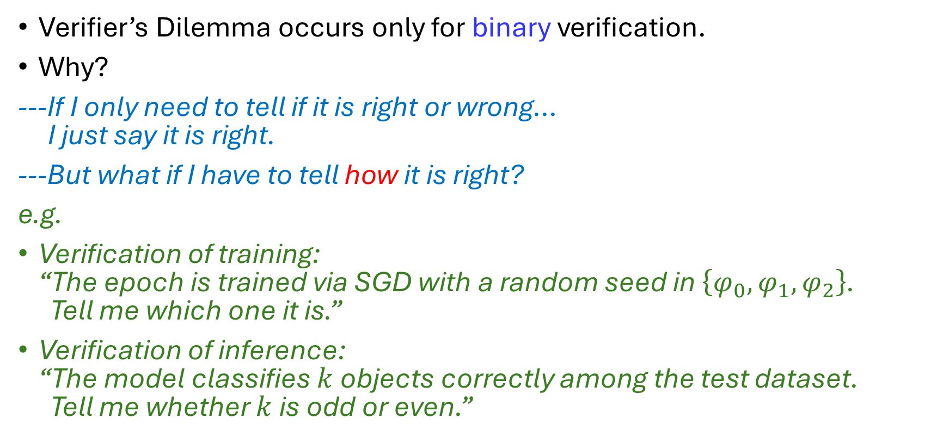
Verifier’s Dilemma: A Non-Binary Escape
Verifier’s Dilemma occurs only for binary verification.
Why?
---If I only need to tell if it is right or wrong… I just say it is right.
---But what if I have to tell how it is right?
e.g.
Verification of training: “The epoch is trained via SGD with a random seed in $\left\{φ_{0},φ_{1},φ_{2}\right\}$. Tell me which one it is.”
Verification of inference: “The model classifies $k$ objects correctly among the test dataset. Tell me whether $k$ is odd or even.”

Slide 36
Verifier’s Dilemma: A Non-Binary Escape
Main Takeaway: Why should we not use binary verification scheme?
We need “flags” to ensure uncertainty in honest verification.
Also called “Attention Challenges”.

Slide 37
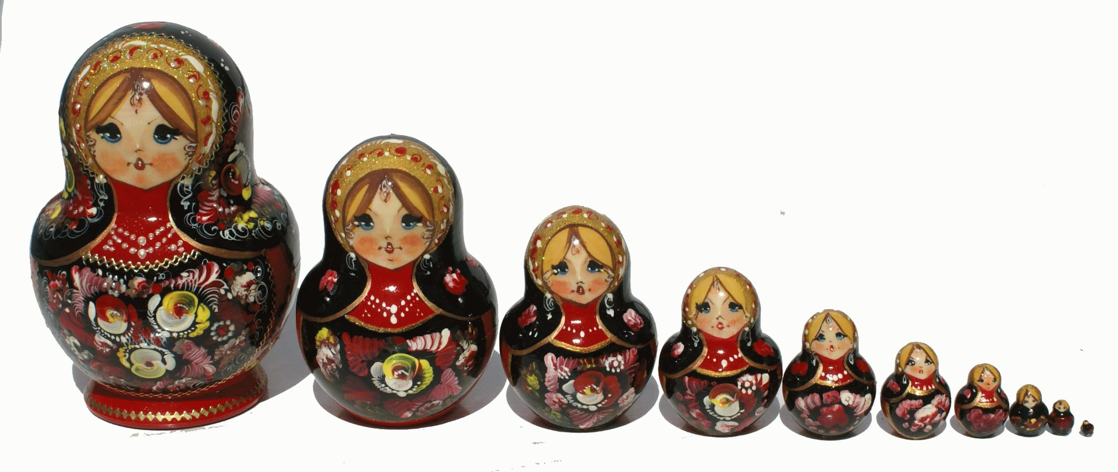
Attempted Solution: Capture-The-Flag (CTF)
Existing works (e.g. Truebit (Teutsch & Reitwießner, 2024)): inject additional information (“flags”, non-binary verification) and reward detection of flags.
May prevent lazy behavior, but what about malicious verifiers?
If the verification result is also expensive to verify…
We need higher-level verifiers to verify the results.
How many layers of verifiers do we need?
Notes:
An intuitive way is to use a higher-level verifiers to verify them.
Some blockchain systems actually did that, sacrificing some decentralization.
But remember that we want a fully decentralized AI.

Slide 38
Intuition: Decentralized Verification Game
Essential takeaway: verifiers also need to be verified.
---Can we just put them in equal positions to verify each other?
“Do I think of something familiar…?”
Yes, peer prediction!

Slide 39


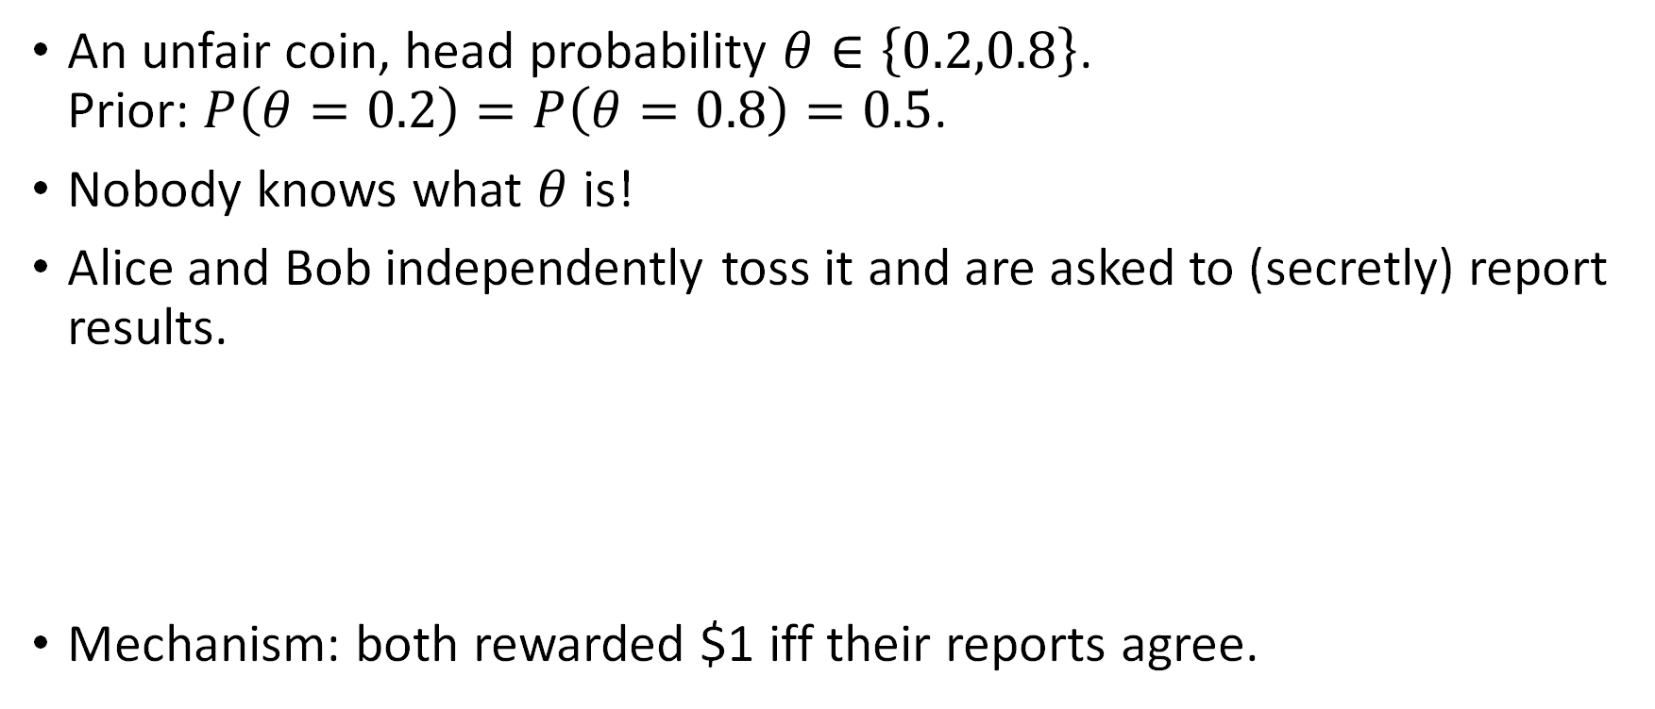
Peer Prediction: Toy Example
An unfair coin, head probability $θ∈\left\{0.2,0.8\right\}$. Prior: $P\left(θ=0.2\right)=P\left(θ=0.8\right)=0.5$.
Nobody knows what $θ$ is!
Alice and Bob independently toss it and are asked to (secretly) report results.
Mechanism: both rewarded $1 iff their reports agree.

Slide 40
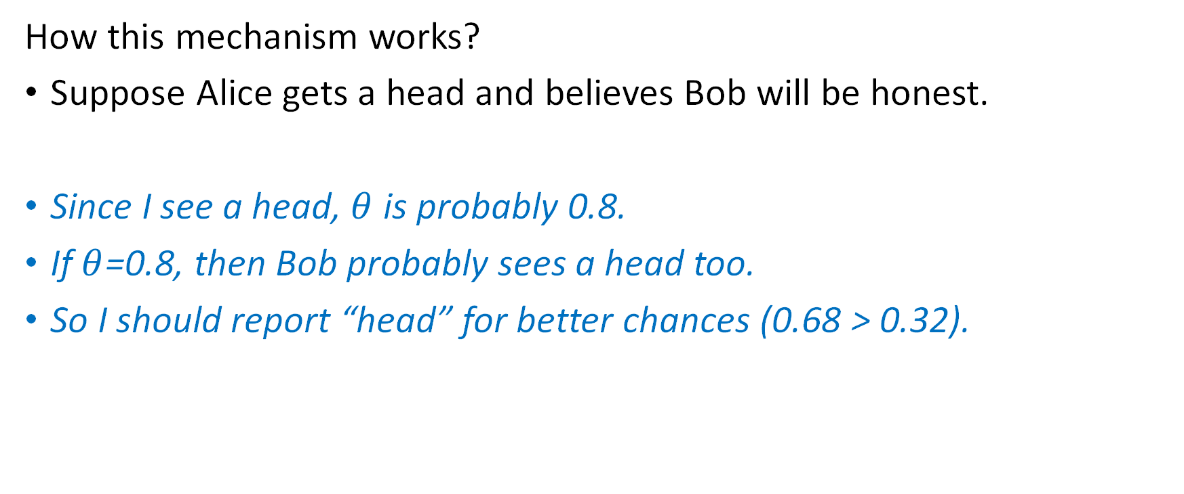
Peer Prediction: Toy Example (cont’d)
How this mechanism works?
Suppose Alice gets a head and believes Bob will be honest.
Since I see a head, $θ$ is probably 0.8.
If $θ$=0.8, then Bob probably sees a head too.
So I should report “head” for better chances (0.68 > 0.32).

Slide 41
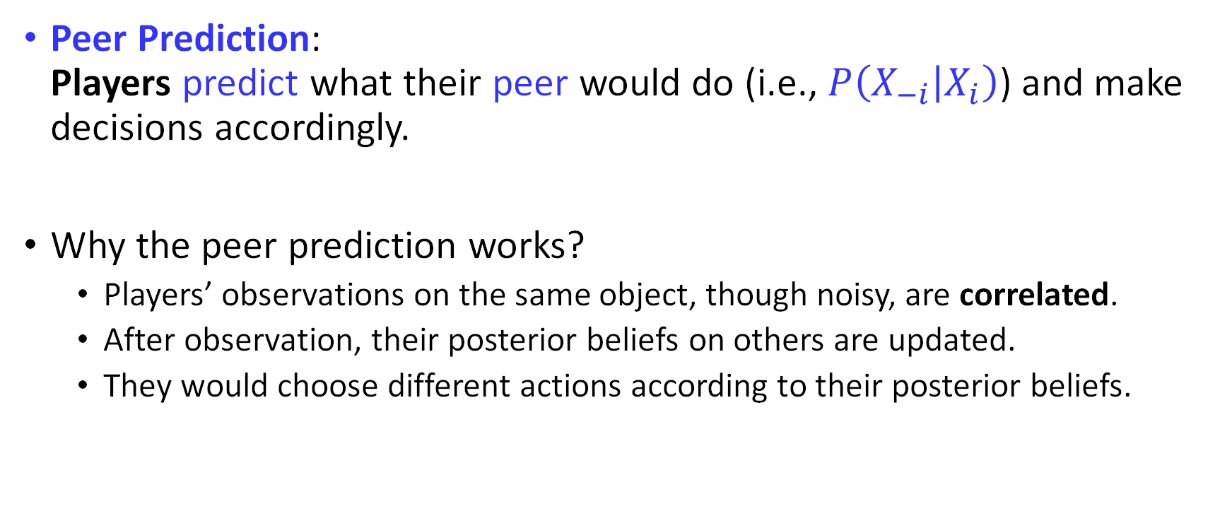
Peer Prediction: General Idea
Peer Prediction: Players predict what their peer would do (i.e., $P\left(X_{−i} | X_{i}\right)$) and make decisions accordingly.
Why the peer prediction works?
Players’ observations on the same object, though noisy, are correlated.
After observation, their posterior beliefs on others are updated.
They would choose different actions according to their posterior beliefs.

Slide 42
Peer Prediction: A Confusing Name?
The name might be confusing as it describes what players do.
What does the mechanism do?
Incentivizing truthful report (action) without access to ground truth.
Valuable for (fully) decentralized environments!
Quite under-explored in studies of blockchain & decentralized consensus mechanism design.

Slide 43
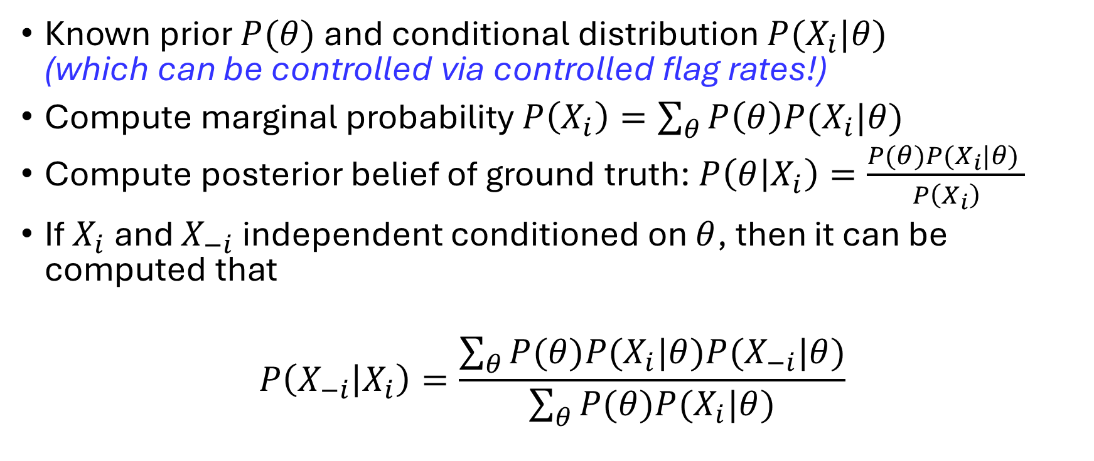
Peer Prediction: Technical Guideline
Known prior $P(θ)$ and conditional distribution $P(X_{i}|θ)$ (which can be controlled via controlled flag rates!)
Compute marginal probability $P\left(X_{i}\right)=\sum_{θ}{P\left(θ\right)P(X_{i}|θ)}$
Compute posterior belief of ground truth: $P\left(θ | X_{i}\right)=\frac{P(θ)P(X_{i}|θ) }{P\left(X_{i}\right)}$
If $X_{i}$ and $X_{−i}$ independent conditioned on $θ$, then it can be computed that
$$P\left(X_{−i} | X_{i}\right)=\frac{\sum_{θ}{P(θ)P(X_{i}|θ)P(X_{−i}|θ)}}{\sum_{θ}{P(θ)P(X_{i}|θ)}}$$

Slide 44
What is the Blockchain: Another Perspective
Peer Prediction: information elicitation mechanisms incentivizing truthful report without access to ground truth.
What is the blockchain?
A (probably) fanciest application of (implicit) peer prediction!

Slide 45
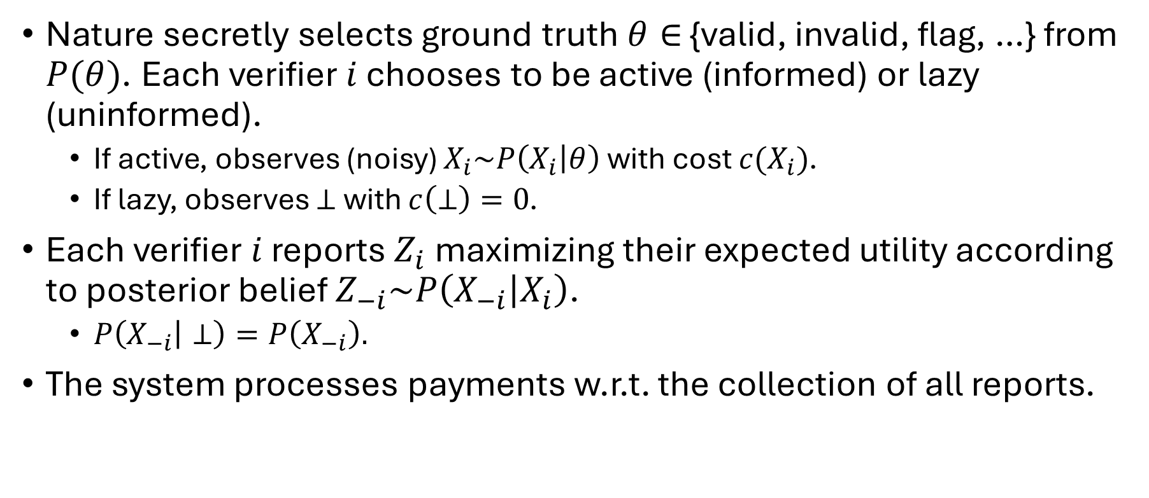
Peer Prediction: The Pipeline
Nature secretly selects ground truth $θ∈$ {valid, invalid, flag, …} from $P(θ)$. Each verifier $i$ chooses to be active (informed) or lazy (uninformed).
If active, observes (noisy) $X_{i}\sim P\left(X_{i} | θ\right)$ with cost $c(X_{i})$.
If lazy, observes $⊥$ with $c\left(⊥\right)=0$.
Each verifier $i$ reports $Z_{i}$ maximizing their expected utility according to posterior belief $Z_{−i}\sim P\left(X_{−i} | X_{i}\right)$.
$P\left(X_{−i} | ⊥\right)=P\left(X_{−i}\right).$
The system processes payments w.r.t. the collection of all reports.

Slide 46
Peer Prediction: Theoretical Guarantees
Main Theorem: For any non-degenerate 2-party decentralized verification games, there exists a peer prediction mechanism satisfying desired incentive properties.
How to generalize to multi-party DVG?
Match each party with everyone else and take the average!
@Mean-field games
How to find the mechanism?
Linear Programming!

Slide 47
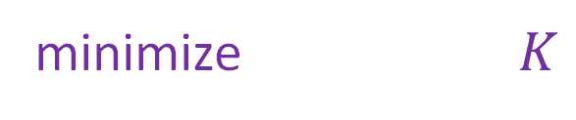
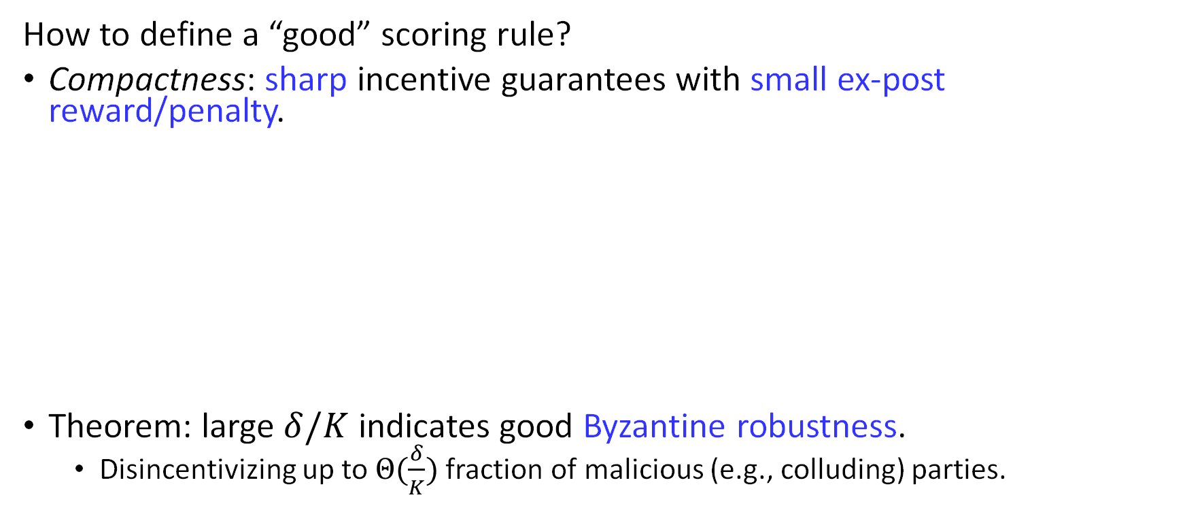
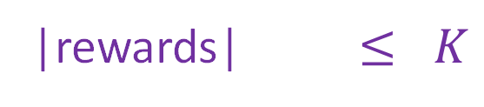
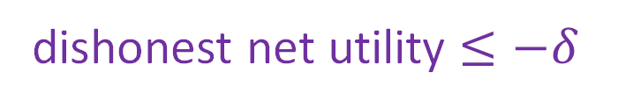
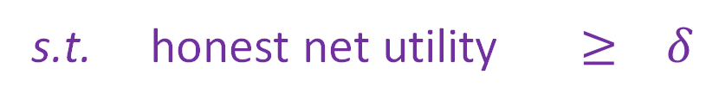
Peer Prediction: Optimization
How to define a “good” scoring rule?
Compactness: sharp incentive guarantees with small ex-post reward/penalty.
Theorem: large $δ/K$ indicates good Byzantine robustness.
Disincentivizing up to $Θ(\frac{δ}{K})$ fraction of malicious (e.g., colluding) parties.
minimize $K$
s.t. honest net utility $≥ δ$
dishonest net utility $≤−δ$
|rewards| $≤ K$

Slide 48
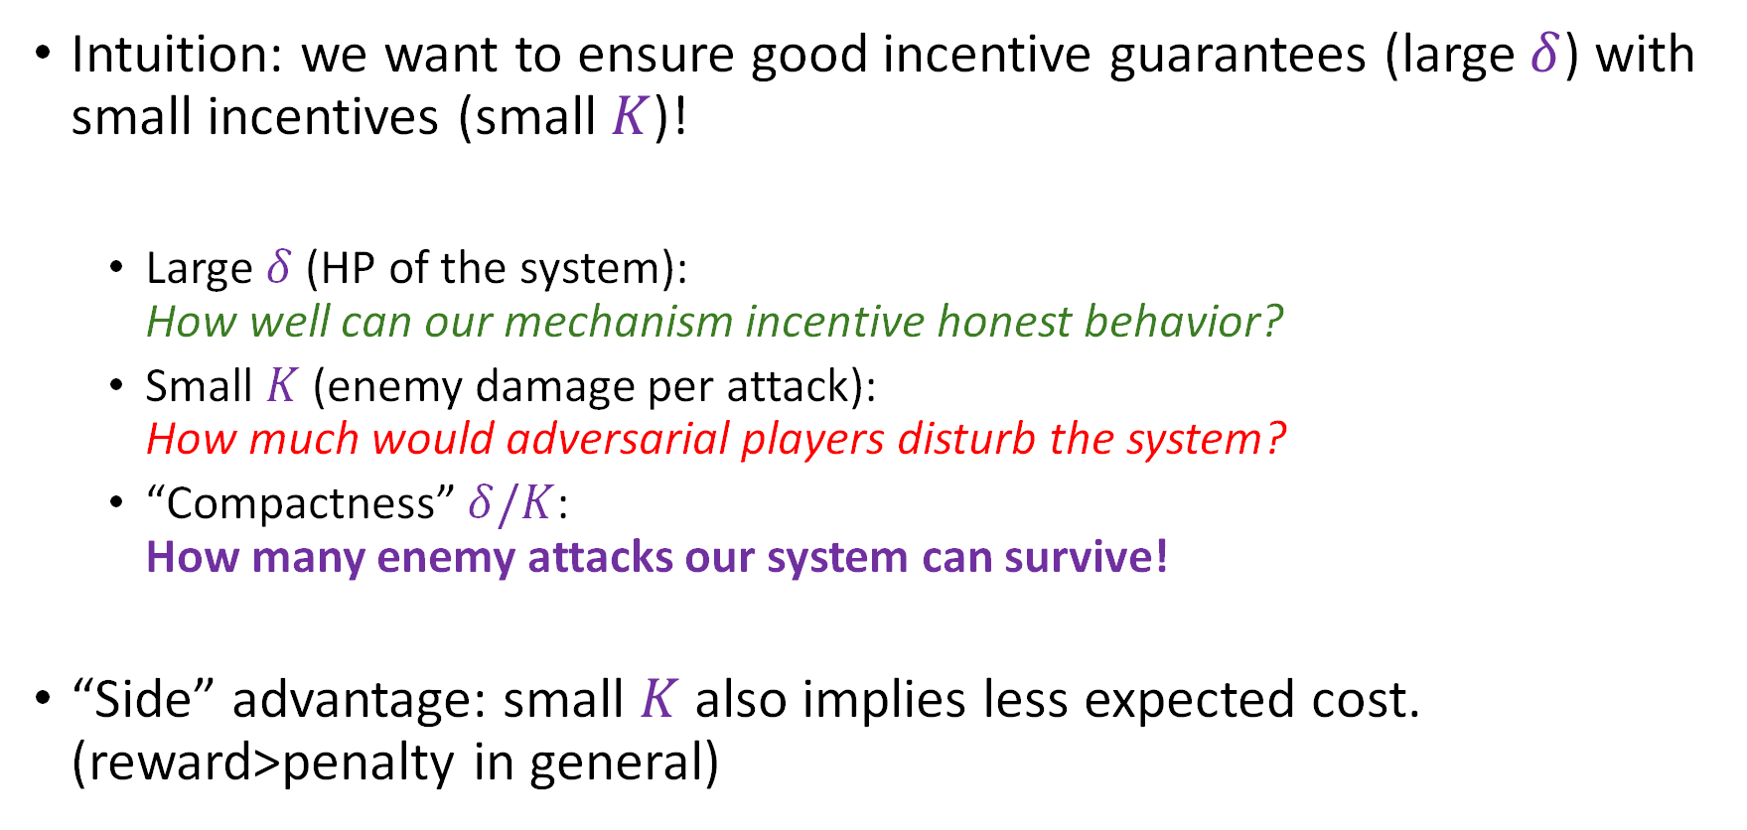
Compactness Criteria: Philosophy
Intuition: we want to ensure good incentive guarantees (large $δ$) with small incentives (small $K$)!
Large $δ$ (HP of the system): How well can our mechanism incentive honest behavior?
Small $K$ (enemy damage per attack): How much would adversarial players disturb the system?
“Compactness” $δ/K$: How many enemy attacks our system can survive!
“Side” advantage: small $K$ also implies less expected cost. (reward>penalty in general)

Slide 49
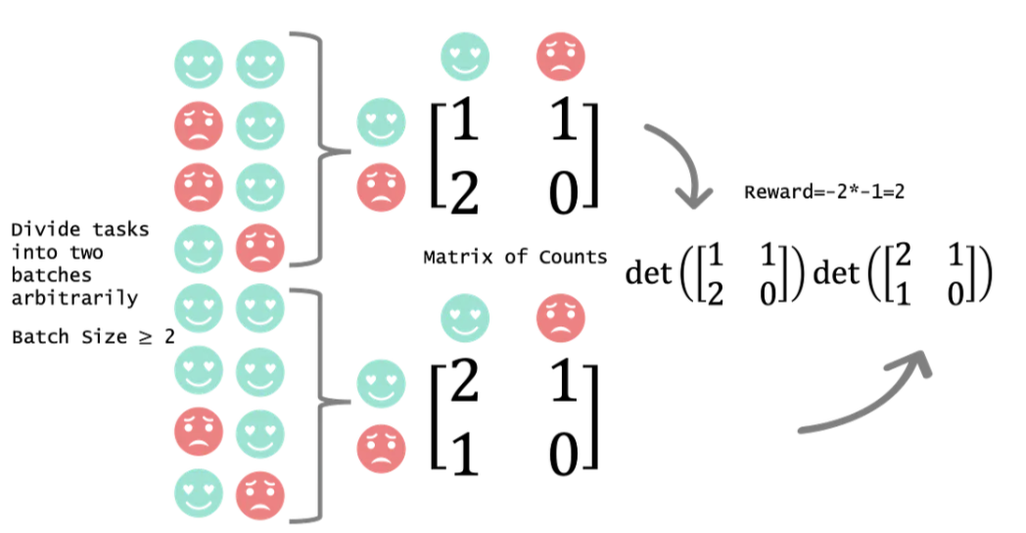
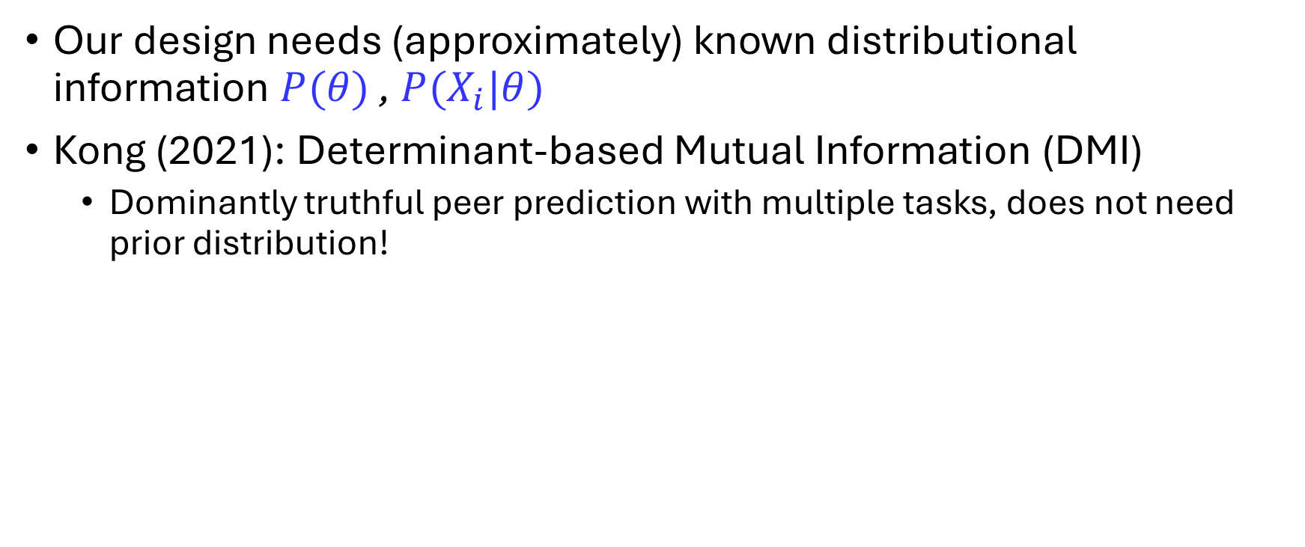
Discussion: Why not use DMI?
Our design needs (approximately) known distributional information $P(θ)$ , $P(X_{i}|θ)$
Kong (2021): Determinant-based Mutual Information (DMI)
Dominantly truthful peer prediction with multiple tasks, does not need prior distribution!

Slide 50
Discussion: Why not use DMI? (1)
The DMI mechanism is not permutation-proof.
A verifier can vote to reject all honest proofs and accept all dishonest proofs, without losing their expected rewards.
No permutation-proof prior-free peer prediction mechanisms exist. (Kong and Schoenebeck, 2019)
DMI elicits informative reports, not necessarily trustworthy ones.
Might be enough to train a good model, but not enough for credibility!
A frequent question: Why do we want truthfulness?
For machine learning, being informative may be enough.
For blockchain/DeAI, truthfulness is the main objective!
Notes:
But remember that this study is motivated by “economics of trust”
At least here, trust is not a tool to make money. In turn, money is a tool to incentivize trust.

Slide 51
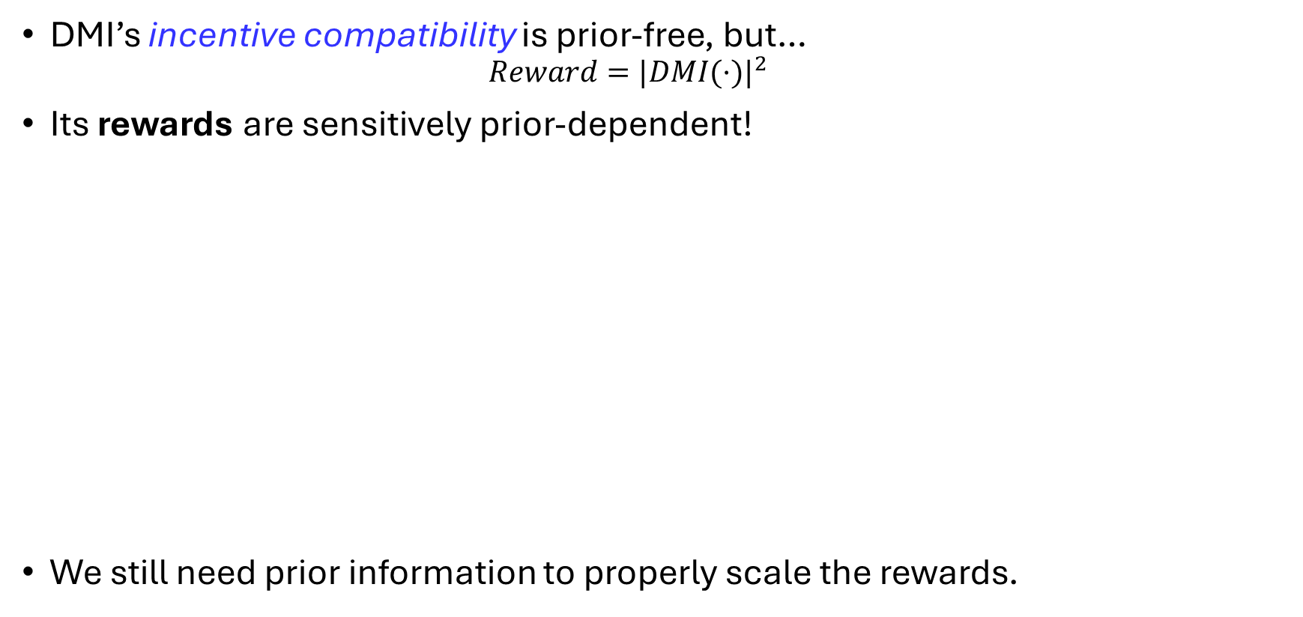
Discussion: Why not use DMI? (2)
DMI’s incentive compatibility is prior-free, but…
$$Reward={|DMI(·)|}^{2}$$
Its rewards are sensitively prior-dependent!
We still need prior information to properly scale the rewards.

Slide 52
Beyond DeAI: Connection with Online Learning
David: “You should learn a little about online learning!”
I (2023): Why? So many operation researchers work on online learning…
What is online learning?
You need to act before you are well prepared.
Why do we need to be impatient?
The world is impatient. We can live ~30 days without food.
I need to get on job market before I finish my papers.
Neither can the system wait 10 years until getting enough data.

Slide 53
Robust Mechanism Design x Online Learning
Philosophy of Online Learning:
Use (calculated) inaccurate information to make decisions;
Then use feedback to improve the knowledge.
Mechanism design:
May need prior information, but how we get it?
Robust mechanism design:
Pay “cost of robustness” for incentive guarantees even under inaccurate information;
With more information, less robustness needed, less cost paid.
Synergy with online learning!

Slide 54
Working Project
Adaptive Mechanism Design with Rational Experts
with David Simchi-Levi, Renfei Tan, Qiushi Han.
Not so “decentralized”, but
Combining mechanism design and online learning to acquire quality data for (traditional) AI systems via economic incentives.

Slide 55
Extension: My Recent Work
In AI training/inference, computation may be noisy due to rounding (and possibly other) errors.
To apply in practice, we may need a consensus mechanism in a continuous domain.
Most existing peer prediction mechanisms mainly work for discrete signal spaces…
T’AIMER: Trustworthy AI Model pEer veRification mechanism

Slide 56
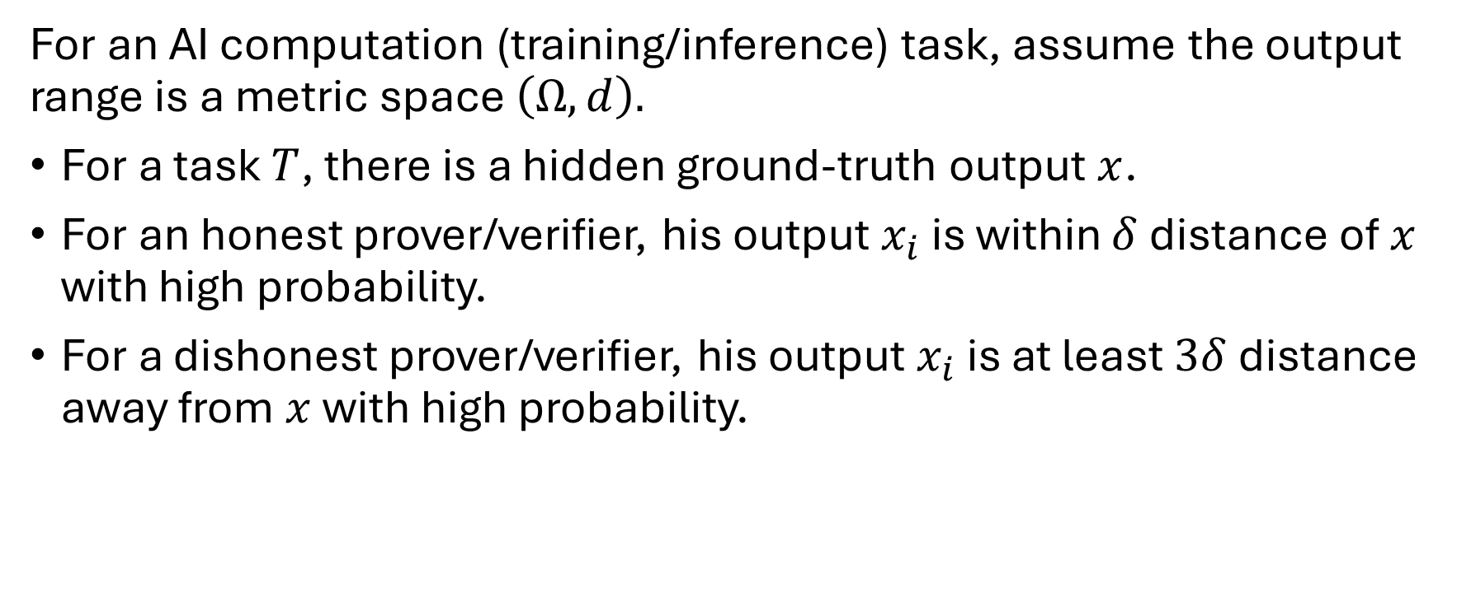
T’AIMER: Modeling
For an AI computation (training/inference) task, assume the output range is a metric space $\left(Ω,d\right).$
For a task $T$, there is a hidden ground-truth output $x$.
For an honest prover/verifier, his output $x_{i}$ is within $δ$ distance of $x$ with high probability.
For a dishonest prover/verifier, his output $x_{i}$ is at least $3δ$ distance away from $x$ with high probability.

Slide 57
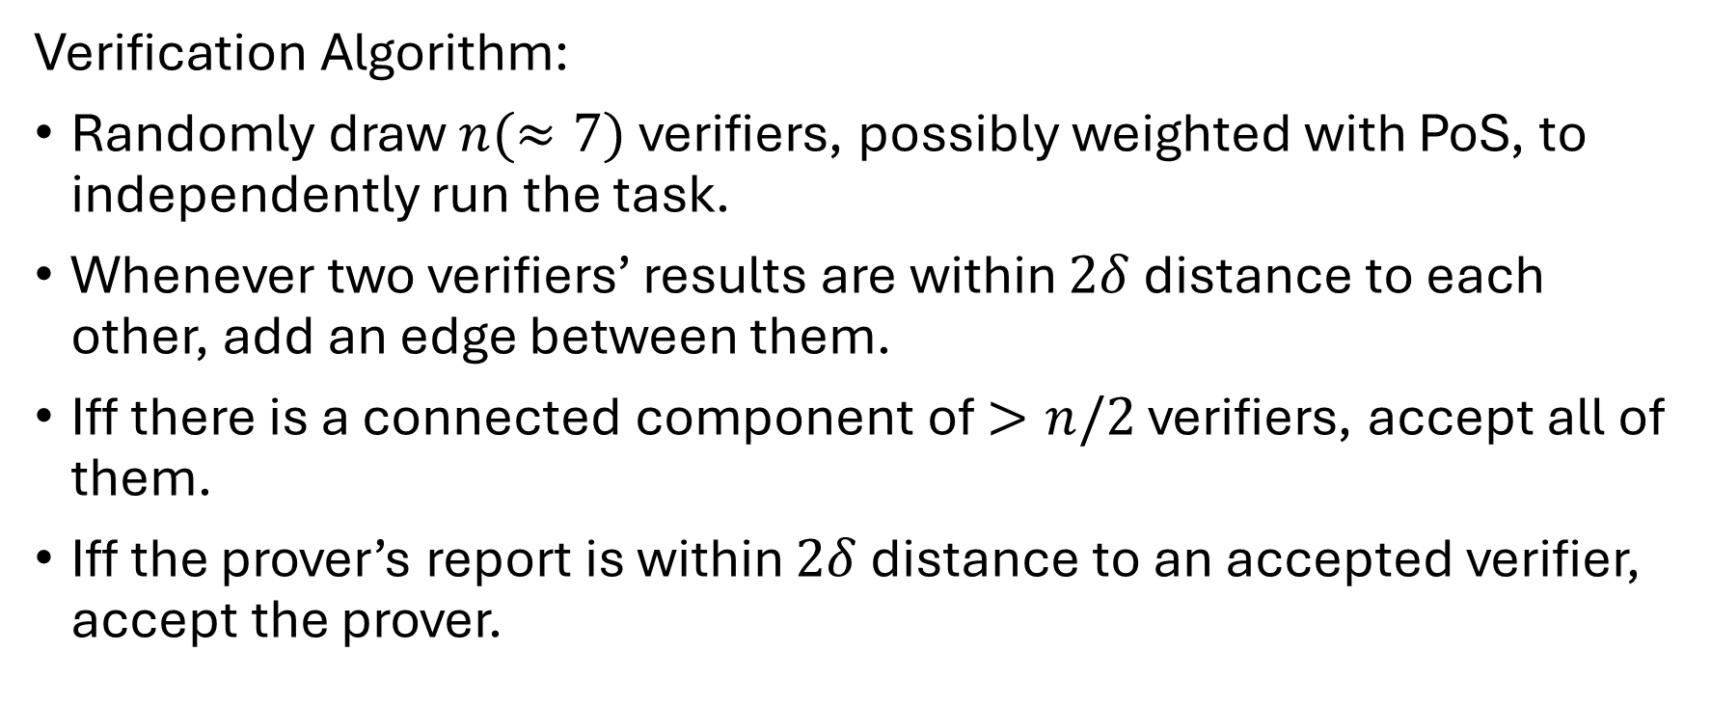
T’AIMER: Clustering Consensus
Verification Algorithm:
Randomly draw $n(≈7)$ verifiers, possibly weighted with PoS, to independently run the task.
Whenever two verifiers’ results are within $2δ$ distance to each other, add an edge between them.
Iff there is a connected component of $>n/2$ verifiers, accept all of them.
Iff the prover’s report is within $2δ$ distance to an accepted verifier, accept the prover.

Slide 58
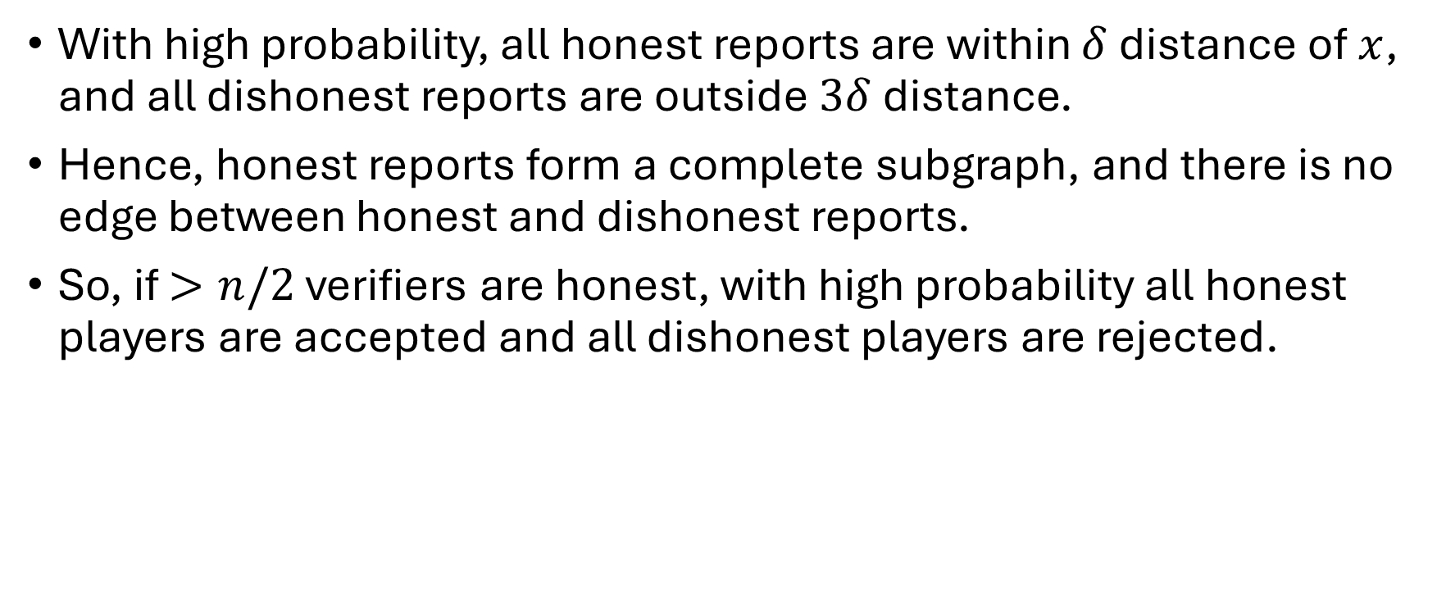
T’AIMER: Analysis Sketch
With high probability, all honest reports are within $δ$ distance of $x$, and all dishonest reports are outside $3δ$ distance.
Hence, honest reports form a complete subgraph, and there is no edge between honest and dishonest reports.
So, if $>n/2$ verifiers are honest, with high probability all honest players are accepted and all dishonest players are rejected.

Slide 59
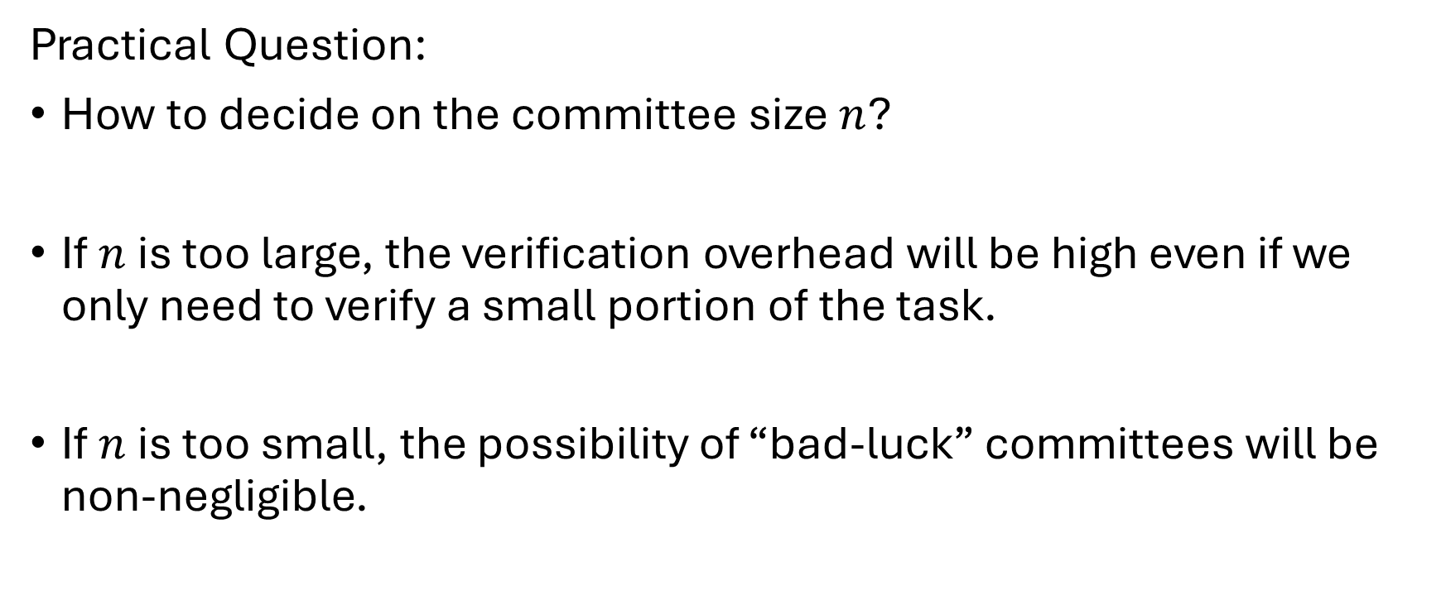
T’AIMER: Discussion
Practical Question:
How to decide on the committee size $n$?
If $n$ is too large, the verification overhead will be high even if we only need to verify a small portion of the task.
If $n$ is too small, the possibility of “bad-luck” committees will be non-negligible.

Slide 60
T’AIMER: Discussion (cont’d)
Bad-luck Collusion:
An adversarial attacker captures 30% (<50%) of the verification node pool, and in a verification task, 5 of 7 committee nodes may happen to be in his control.
Attacker’s strategy: Attacks when the committee has 4 of his controlled nodes, and does not attack otherwise.
I already have an amazing solution! (not disclosed yet ^_^)

Slide 61
Wrap-Up: Meta-Incentive of DeAI
A question to me: Why decentralization?
Decentralized AI is quite a difficult topic to work on.
“If you are strong enough to decentralize, why not be the center instead?”
“Trust is more precious than domination.”
And it is a pleasure to work on the economics of it.

Slide 62
Conclusion
Am I really doing operation research?
Operation researchers strive for optimality.
We should iteratively improve existing results, for better bounds, etc.
My design might be far from optimal.
But I only try to explore a possibility.
If valuable, other ORers will surely optimize it later!
For those who come after!

Slide 63
Proof-of-Learning with Incentive Security
Zishuo Zhao, Zhixuan Fang, Xuechao Wang, Xi Chen, Hongxu Su, Haibo Xiao, Yuan Zhou
https://arxiv.org/abs/2404.09005
It Takes Two: A Peer-Prediction Solution for Blockchain Verifier's Dilemma
Zishuo Zhao, Xi Chen, Yuan Zhou
https://arxiv.org/abs/2406.01794
VeriLLM: A Lightweight Framework for Publicly Verifiable Decentralized Inference
Ke Wang, Zishuo Zhao, Xinyuan Song, Bill Shi, Libin Xia, Chris Tong, Lynn Ai, Felix Qu, Eric Yang
https://arxiv.org/abs/2509.24257
T’AIMER: Trustworthy AI Model pEer veRification mechanism
(working project)

Slide 64
Q&A

